Slide 1
INTERNSHIPS

Slide 2
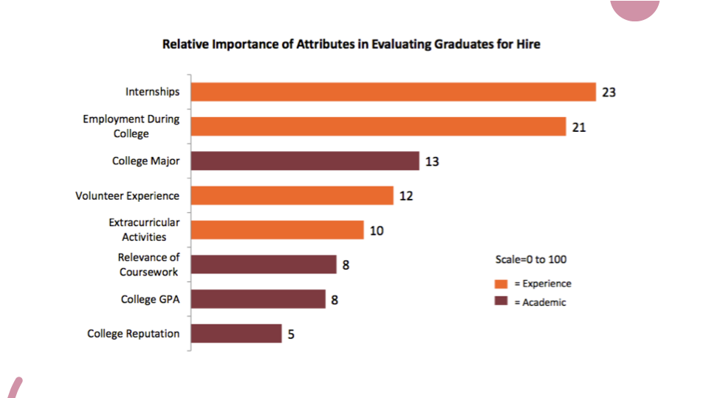

Slide 3
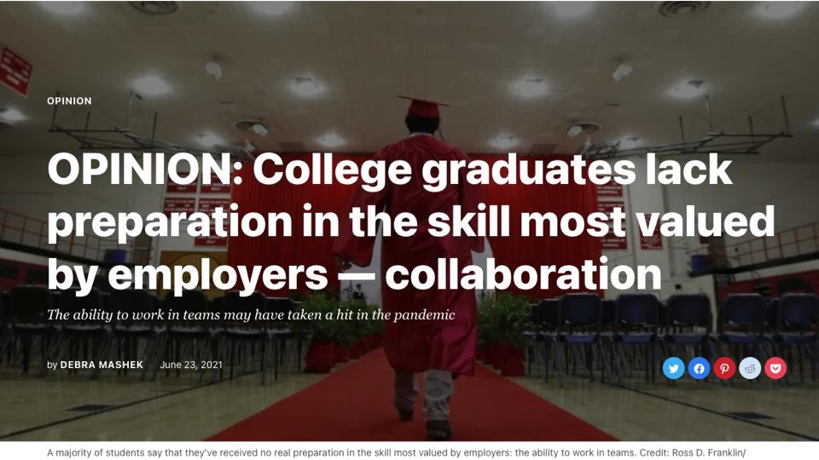
A
A majority of students say that they’ve received no real preparationin the skill most valued by employers: the ability to work in teams. Credit: Ross D. Franklin

Slide 4
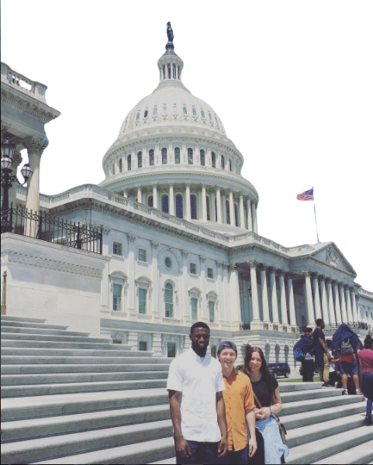
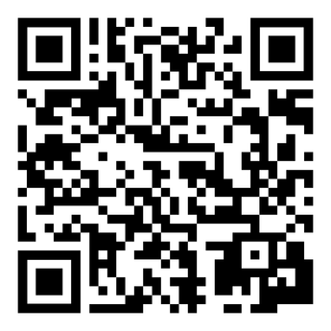
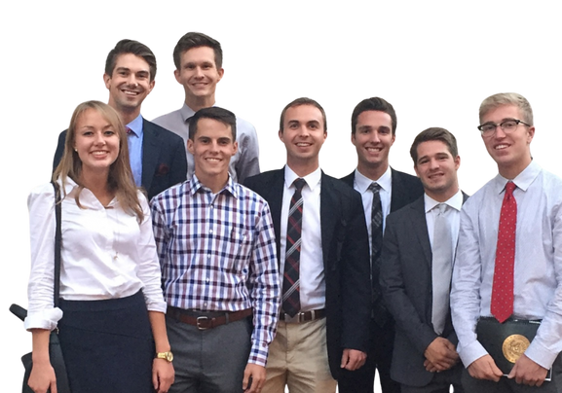
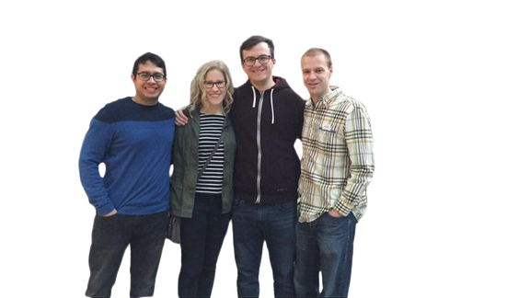
WASHINGTON SEMINAR
Internships in Washington, DC
UTAH STATE LEGISLATURE
Internships
  Live and intern in Washington, DC
  Winter, Spring-Summer, and Fall Cohorts
  Up to 12 credit hours
  BYU housing in DC
  Grant funding
  Intern with an elected official in the Utah Legislature
  Winter semester
  $4000 stipend
  Up to 15 credit hours
  Live in Provo
APPLICATION DEADLINE
W 2025: OCT 15, 2024
APPLICATION DEADLINES
W 2025: Sept 20, 2024
SS 2025: Nov 20, 2024
F 2025: Feb 10, 2025
CAMPUS PROFESSIONALS
SITE VISIT
FEBRUARY 2025:
SCAN FOR MORE INFO OR TO APPLY:
FHSSInternships.byu.edu

Slide 5
When should I complete an internship?
  Internships work best after you have 3-4 semesters on campus
How will I afford an internship?
  Program grant funding through Washington Seminar
  Grant funding for internships at fhssinternshipgrants.byu.edu
Is it best to be a
political science student?
  We work with all majors in a wide range of internships.
  Any and all are welcome to apply.
Do I need to have an internship to join the program?
  Some students apply with an internship lined up, but most apply without an internship.
  Students seeking an internship are mentored by our team.
  We offer support and resources as students apply for internships.
WHAT QUESTIONS DO YOU ANTICIPATE YOUR STUDENTS ASKING?

Slide 6
Helping students see past assumptions about the “right” internship.

Slide 7
2024 MAJORS IN DC
...AND WHERE THEY INTERNED
ACCOUNTING:
MCKEON GROUP
ENGLISH:
AMERICAN LEGISLATIVE EXCHANGE COUNCIL
AG LEGAL
AMERICAN STUDIES:
NATIONAL CENTER ON SEXUAL EXPLOITATION
ENVIRONMENTAL SCIENCE & SUSTAINABILITY:
SENATOR MITT ROMNEY
BIOLOGY:
SENATOR RAND PAUL
EXPERIENCE DESIGN AND MANAGEMENT:
DISTRICT OFFICES
US DEPARTMENT OF EDUCATION
BUSINESS:
SENATOR MITT ROMNEY
COMMS - JOURNALISM:
BREAKFAST MEDIA
FAMILY LIFE:
CONGRESSIONAL COALITION ON ADOPTION INSTITUTE
DC OFFICE OF THE ATTORNEY GENERAL
COMMS - PR:
REPRESENTATIVE BOEBERT
ECONOMICS:
FREEDOM WORKS
REPRESENTATIVE CURTIS
GEOGRAPHY:
NATIONAL AIR AND SPACE MUSEUM
RELIGIOUS FREEDOM INSTITUTE
THE HERITAGE FOUNDATION

Slide 8
2024 MAJORS IN DC
...AND WHERE THEY INTERNED
HISTORY:
FAHRENHOLZ AND HORRELL
OFFICE OF HISTORIC ALEXANDRIA
NATIONAL DEFENSE UNIVERSITY
SMITHSONIAN
POLITICAL SCIENCE:
WPA INTELLIGENCE
NATIONAL ACADEMY OF PUBLIC ADMINISTRATION
PSYCHOLOGY:
CHILDREN’S NATIONAL HOSPITAL
INTERNATIONAL RESCUE COMMITTEE
INTERNATIONAL RELATIONS:
THE COMMITTEE FOR HUMAN RIGHTS IN NORTH KOREA
PUBLIC HEALTH:
ETHIOPIAN COMMUNITY DEVELOPMENT COUNCIL
HEART OF AMERICA FOUNDATION
MARKETING:
AMERICAN ENTERPRISE INSTITUTE
SOCIOLOGY:
THE BECKETT FUND
NATIONAL IMMIGRATION FORUM
MICROBIOLOGY:
INTERNATIONAL RESCUE COMMITTEE
MIDDLE EASTERN STUDIES:
VOA NEWS CENTER
STRATEGIC MANAGEMENT:
REPRESENTATIVE JOHN CURTIS
PHILOSOPHY:
THE FEDERALIST SOCIETY
UNDECLARED:
MCKEON GROUP

Slide 9

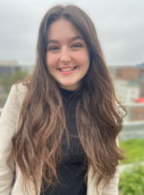

Slide 10

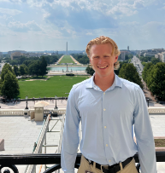

Slide 11
WE’VE MOVED!
YOU CAN FIND US IN 1049 JFSB
or
FHSSINTERNSHIPS.BYU.EDU
WE ARE EAGER TO SUPPORT YOUR STUDENTS IN INTERNSHIP SUCCESS!

