Slide 1
Creating Shared Purpose through More Effective Learning Outcomes
11 February 2022
Notes:
Change the name and change the logo

Slide 2
First Things First
Does everyone have something to write on and to write with?

Slide 3
Education doesn’t always happen in a classroom, or even on a campus.... Hands-on experiences help students to gain perspective and to become excited about learning.... I hope we inspire our students to learn and I hope that learning leads to inspiration.
-President Kevin. J. Worthen

Slide 4
Education doesn’t always happen in a classroom, or even on a campus.... Hands-on experiences help students to gain perspective and to become excited about learning.... I hope we inspire our students to learn and I hope that learning leads to inspiration.
-President Kevin. J. Worthen

Slide 5

Engagement is a prerequisite of learning
We can teach all we want, but if students are unwilling to engage, little to no learning will occur.
Your syllabus is an opportunity to reduce barriers to engagement.

Slide 6
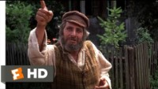
Unlearn to Learn

Slide 7

Historical Perspective—1910’s
Mass production is the new modern method.
  Grade levels
  Standardized curriculum
  Students progress at the same rate
  Objective assessment
In this paradigm, the central question is how to optimize inputs and processes to yield predictable outputs

Slide 8
In the classroom, who controls inputs and processes?

Slide 9
Therefore, who is responsible for learning?

Slide 10
Engagement is a prerequisite of learning
Remember this?

Slide 11
If engagement is necessary, who is responsible for learning?

Slide 12
What is the tone of your syllabus?
Does it invite students to collaborate in the learning process?

Slide 13
Unlearn to Learn II:
Domains of Learning

Slide 14
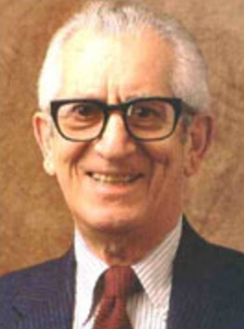
Introduction: Bloom’s Taxonomy
This Photo by Unknown Author is licensed under CC BY-SA-NC

Slide 15
Original Scope of the Committee
Domains of Learning
Cognitive Domain | Psychomotor Domain | Affective Domain
Having to do with thinking, reasoning, logic, and ideas | Having to do with motor control, physical coordination, and skill | Having to do with emotions, attitudes, and relationships

Slide 16
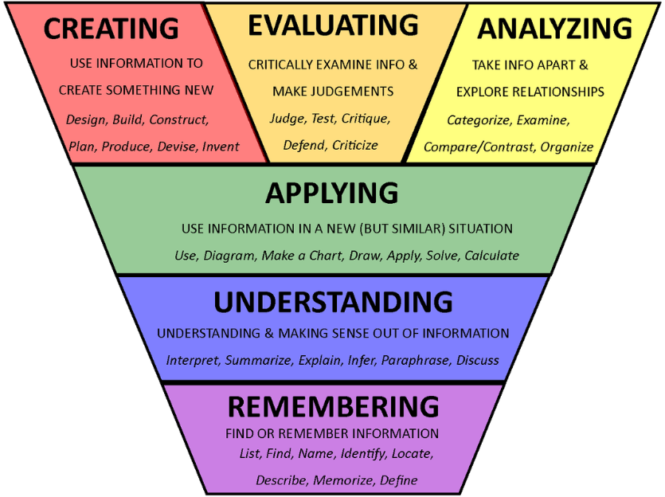
Bloom’s Taxonomy
Today, Bloom’s Taxonomy and the cognitive domain are largely synonymous.
Only the cognitive domain updated in 2001
This Photo by Unknown Author is licensed under CC BY

Slide 17
Relevant domains of learning
Domains of Learning
Cognitive Domain | Psychomotor Domain | Affective Domain | Conative Domain
Having to do with thinking, reasoning, logic, and ideas | Having to do with motor control, physical coordination, and skill | Having to do with emotions, attitudes, and relationships | Having to do with volition, intentionality, and self-regulation

Slide 18
How do we engage student agency in the learning process?

Slide 19
The Power of Shared Purpose
“Purpose provides activation energy for living.”
(Pink, 2009, p.134, quoting Mihalyi Csikszentmihalyi)

Slide 20
Creating a Shared Purpose

Slide 21
What is your purpose?
Write for 5 minutes without worrying about editing.
Consider:
  The internship has ended.
  How will students to be different?
    What will they be able to do?
    Who will they have become?
Please wrap up
1
minutes
2
minutes
3
minutes
4
minutes

Slide 22
What is their purpose?
Write for 5 minutes without worrying about editing.
Consider:
  What might be the purposes of the student?
  How do they hope to be different?
    What do they hope to achieve?
    Who do they hope to become?
Please wrap up
1
minutes
2
minutes
3
minutes
4
minutes

Slide 23
Composing the Picture
Compose a single sentence that consolidates these ideas into
a clear and concise Course Purpose.
Please wrap up
1
minutes
2
minutes
3
minutes
4
minutes
Notes:
We are going to focus on Course Purpose first.
The Learning Outcomes will come later.

Slide 24
Share and Discuss
Share with your group your course purpose.
Please wrap up
1
minutes
2
minutes
3
minutes
4
minutes

Slide 25
What are the differences?
First Draft—Course Purpose | Second Draft—Course Purpose
Course 123 will provide students a beginning opportunity for them to increase their knowledge and understanding regarding tobacco, alcohol, and other addictions with their associated prevention strategies, treatment options, and policy implications | Students will become more empathetic, and wise in engaging, assessing, and intervening with individuals, families, and communities that are struggling with the effects of addiction.
Notes:
1- Clarified & Modified to what students will DO:
“increased their knowledge and understanding…associated…” into “become more empathetic, and wise in engaging, assessing, and intervening” added the WHO “with individuals, families, and communities”
2- Simplified:
“regarding tobacco, alcohol, and other additions” into “addition”

Slide 26
Identify Learning Outcomes
Circle or underline the key ideas in your writing.
Summarize your ideas into three to five statements that help the student know what to do to achieve the course purpose.
These are your learning outcomes.
Please wrap up
1
minutes
2
minutes
3
minutes
4
minutes

Slide 27
Purpose and Outcomes. Basic Statistics
Course Purpose:
    Students will be able to evaluate and produce credible research using statistical methods.
  Learning Outcomes:
    1. Students will be able to evaluate the credibility of statistical methods in journal article abstracts.
    2. Students will be able to select an appropriate statistical method for a given research situation.
    3. Students will be able to correctly run the method chosen for the given research situation.
    4. Students will be able to properly interpret the results of the chosen method for both academic and non-academic audiences.

Slide 28
More Effective Learning Outcomes
Principle 1: Focus on student abilities, not:
  Content or Topics
  Processes, Activities, or Experiences.
  Tools or Resources
  Assignments or Assessments
Principle 2: Verbs should suggest a form of evidence.
Principle 3: Avoid compound outcomes.

Slide 29
Review and Adjust
Review your course purpose and learning outcomes and make adjustments.
Remember: Your course purpose and learning outcomes are not written in stone. They should be reviewed and revised as often as necessary.
Please wrap up
1
minutes
2
minutes
3
minutes

Slide 30
Share and Discuss
Share with your group your course purpose and learning outcomes.
Please wrap up
1
minutes
2
minutes
3
minutes
4
minutes

Slide 31
Wrapping Up

