Slide 1

Vetting Employers
Scott Greenhalgh
10/18/2022
Notes:
Spend more time on employeers with higher disarability score

Slide 2

Why is vetting important?
Assure the quality of companies being introduced to students on Handshake
A way to manage and access the employers contacting campus
Focus on employers with values
Help us better engage with companies

Slide 3

Vetting Employers
1
2
Desirability Score
Handshake Vetting
Notes:
We have two main methods of employers vetting: 1. desirability score and 2. handshake

Slide 4
Vetting Employers for BYU Engagement
Notes:
Spend more time on employeers with higher disarability score

Slide 5
Desirability vs Engagement Level
Notes:
Spend more time on employeers with higher disarability score

Slide 6

Desirability Score (%)
Fortune 500
Universum
Utah Business
Numbers of Alumni working
Alumni Score
Glassdoor
Score
Best Company Lists
Total Score (Sum * 10)
Highest Possible Score
(270)
culture and values
work/life balance
compensation& benefits
career opportunities
Notes:
Desirability score are calculated by taking the following three scores:
1. Best company list (whether or not companies are include in fortune 500; universum or Utah business)
2. Alumni Score (how many alumnus work for the company)
3. Glassdorr score (a external mediate that provides score in the following criteria)
Combine scores from those three areas will give us a total score, we divide that by the highest possible score to get the desirability rate

Slide 7
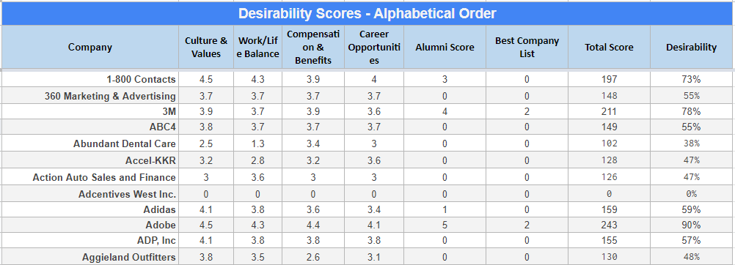
Desirability Score (%)
Examples

Slide 8
Desirability Score (%)
Examples
Rank | Company | Number of Alumni (Linkedin) | Desirability Score (Rank among Top 100) | Contact | Title
1 | Brigham Young University | 9,800 | 80% (T-24) | Donna Piereder | Manager Staff and Administrative Employment
2 | The Church of Jesus Christ of Latter Day Saints | 2,400 | 80% (T-24) | Dimitri Clark | Senior Recruiter, Student Programs
3 | Intermountain Healthcare | 1,400 | 69% (T-86) | Marian Janikula | Executive Recruiter
4 | Brigham Young University - Idaho | 896 | 19% (100) | Taylor Woods | Employment and Regulatory Compliance
5 | Qualtrics | 718 | 79% (T-31) | Kyra Toyama | Recruiter
6 | Adobe | 667 | 90% (01) | Manali Dutta Chowdhury | University Talent Scout, Technical Recruiting
7 | Intel | 599 | 86% (T-06) | Sarah Harrison | Intern & College Graduate Program Manager, Sales and Marketing
8 | United States Air Force | 587 | 77% (T-41) | Carl Ybarra | Senior Operations Coordinator
9 | Microsoft | 565 | 88% (02) | Maggie Bott | Industry Recruiter
10 | Amazon | 550 | 80% (T-24) | Ben Raynor | Senior Recruiter, Student Programs
11 | doTERRA | 539 | 76% (T-48) | Tami Teriipaia | Campus Recruiter & Internship Program Leader
12 | Vivint | 536 | 66% (T-96) | Kimberly Wittman | Vice President, Talent Acquisition & HR Business Partner Technology
13 | U.S. Army | 451 | 74% (T-59) | Amy Miller | Supervisory HR Specialist
14 | Boeing | 430 | 81% (T-20) | Michael Gitto | Director, Labor Relations
15 | Alpine School District | 427 | 77% (T-41) | Cami Larsen | Administrator of Human Resources
16 | Nebo School District | 418 | 74% (T-59) | Lana Hiskey | Communications & Community Relations Administrator
17 | Deloitte | 384 | 73% (T-72) | Brittany Cicmanec | Campus Recruiting Coordinator
18 | Jordan School District | 377 | 68% (T-91) | June LeMaster | Human Resources Administrator
19 | Wells Fargo | 372 | 79% (T-31) | Danita Minor | Senior Recruiting Consultant
20 | FamilySearch | 371 | 78% (T-35) | Annette Tucker-Matkin | Senior Human Resources Business Partner
21 | University of Utah Health | 356 | 77% (T-41) | Alberta Elstein | Department of Pediatrics HR & Academic Coordinator
22 | Northrop Grumman | 355 | 84% (T-11) | Shannell Crabtree | Manager, Talent Acquisition
23 | Goldman Sachs | 348 | 80% (T-24) | Jessie Lawless | Vice President, Global Head of Campus Recruiting - Consumer and Wealth Management
24 | University of Utah | 345 | 77% (T-41)
25 | Fidelity Investments | 334 | 87% (T-03) | Jan Whitesides | Talent Acquisition & Management Executive

Slide 9
Vetting Employers for Handshake
Notes:
Spend more time on employeers with higher disarability score

Slide 10

Handshake Vetting
Trust Score
Flags
Details
Above 80%
Handshake's flagging system gives higher ed partners the ability to alert the Trust and Safety team of any fraud or abuse regarding a company, user, or job posting in Handshake.
Employers found to be in violation of the terms of service may have their company fully suspended, or individual users and/or jobs may be suspended. Handshake team will notify the user that placed the flag, as well as any other users impacted.
Information provided by companies includes company description, website, contact information, address etc.
Before we approved them, we will make sure those information are included and accurate.
*Both schools and companies could make notes on handshake, if a company didn’t pass due to lack of detail information. they are able to find out the missing parts through communicating with us and improve before we approve them.
60-80%
40-60%
Below 40%
Scores generated by Handshake based on Employer's general activity on Handshake
Sometimes handshake doesn’t have a trust score if it’s a new company; but it will show the data of the numbers of school approved or denied, which is the factor we used to vet
Notes:
There are three criteria to vet employers on handshake:
Trust score (Handshake automatically calculates a Trust Score for each employer on the platform. This Trust Score is assigned to help Career Services teams easily view, at a glance, an Employer's general activity on Handshake.)
Flags (Schools using handshake are able to flag a company)
Company details ( company description whether or not they have a company email, phone number, website, address etc.)
Note that there are exceptions: 1. we are trying to promote automatic approval with school that has a trust score higher than 80%; 2. sometimes companies forgot to include some of the detail information or it’s new and the website haven’t fully set up, companies can leave a note if they are not approved and we can communicate with them to improve their profile in order to get approved

Slide 11
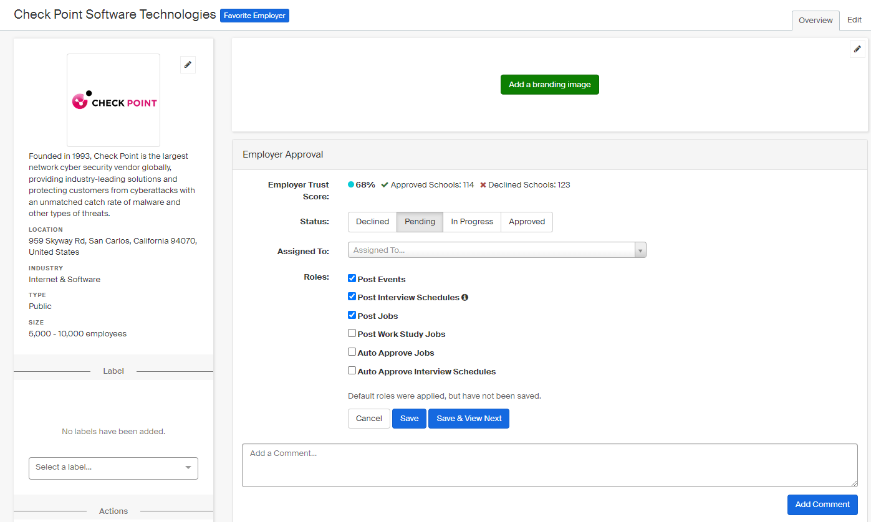
Handshake Vetting
Trust Score
Detail

Slide 12
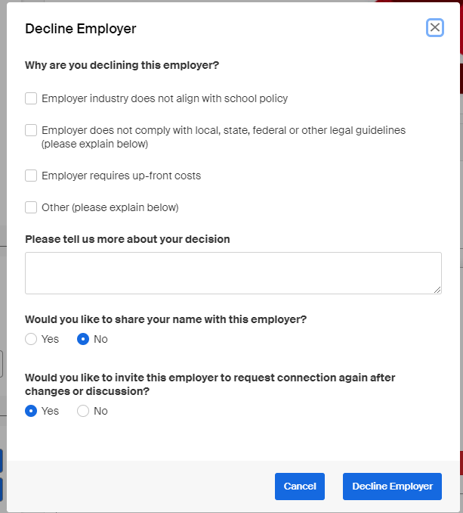
Handshake Declining

Slide 13
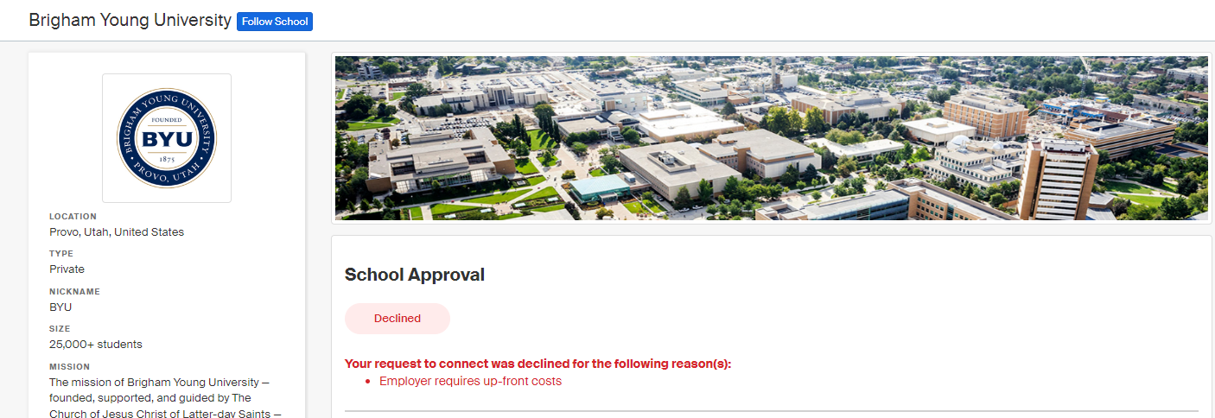
Handshake Employer View
Employer are able to see the reason

Slide 14
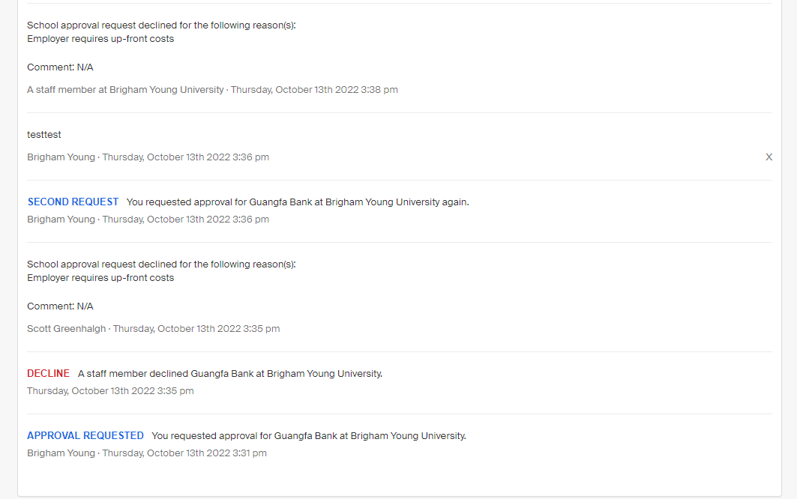
Handshake Employer View
Choose not share your name
Choose sharing name

Slide 15
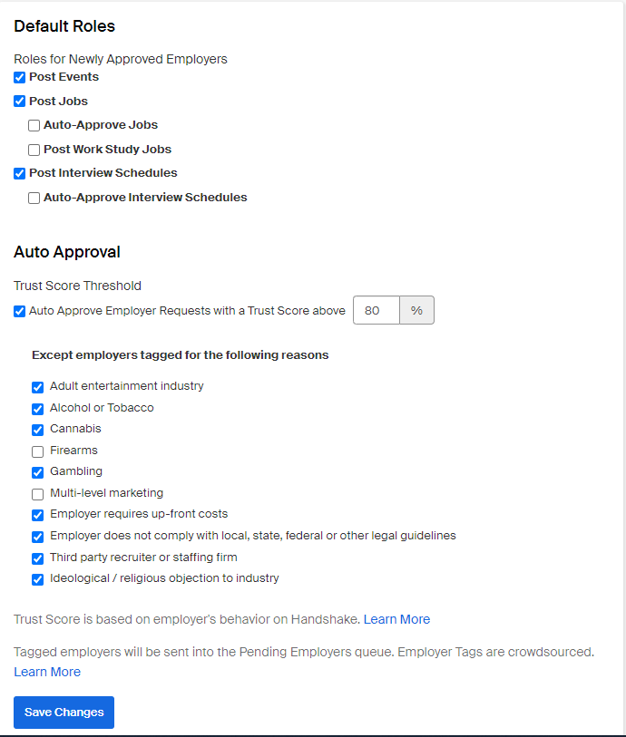
Change in vetting
Soon Handshake will be doing the vetting of employers. We are making some changes now to make that change less drastic
Exceptions for automatic approval

Slide 16
Thank you
Notes:
Spend more time on employeers with higher disarability score

