Slide 1
Self-Directed Learning During the Internship: Reflection-in-Action and Reflection-on-Action
March 2022
Notes:
Change the name and change the logo

Slide 2
“The unexamined life is not worth living”
~ Socrates

Slide 3
“The unexamined [internship] is not worth [doing]”
~ Socrates

Slide 4
“Some people live and learn, other people just live.”
~My mother-in-law

Slide 5
The Experiential Learning Cycle (Kolb, 1984)
Concrete
Experience
Active Experimentation
Reflective
Observation
Abstract Conceptualization

Slide 6
Domains of Learning
Cognitive Domain | Affective Domain | Psychomotor Domain | Conative Domain
thinking, reasoning, and communicating | attitudes, emotions, and relationships | motor control, physical coordination, and skill | volition, intentionality, and self-discipline
Project/Paper Performance Exams | Reflection Survey Performance | Performance Project | Reflection Performance Project
Notes:
Examples of Bryan’s Swimming Example from the psychomotor domain and similarly in the cognitive domain we can reflect on process, etc., to help students be more thoughtful about work on a project where we only see final project…

Slide 7
Reflecting-on-Action vs. Reflecting-in-Action*
What’s the difference and why does it matter?
*From Donald Schön, Educating the Reflective Practitioner, 1987

Slide 8
Metacognitive Reflection / Self-Direct Learning Cycle
Plan
Execute
Monitor
Evaluate
Notes:
Plan: Assess the task, Determine What You Need to Learn, Create the Plan/Stategy
Execute: Apply strategies - Self-direction to carry out the plan
Monitor: Sticking with the plan or not? Making progress toward the goal? Adjustments needed?
Evaluate: Did I accomplish my goal? How well? How effective was my plan? What will I do next time (keep doing and/or change) I face a similar task?

Slide 9
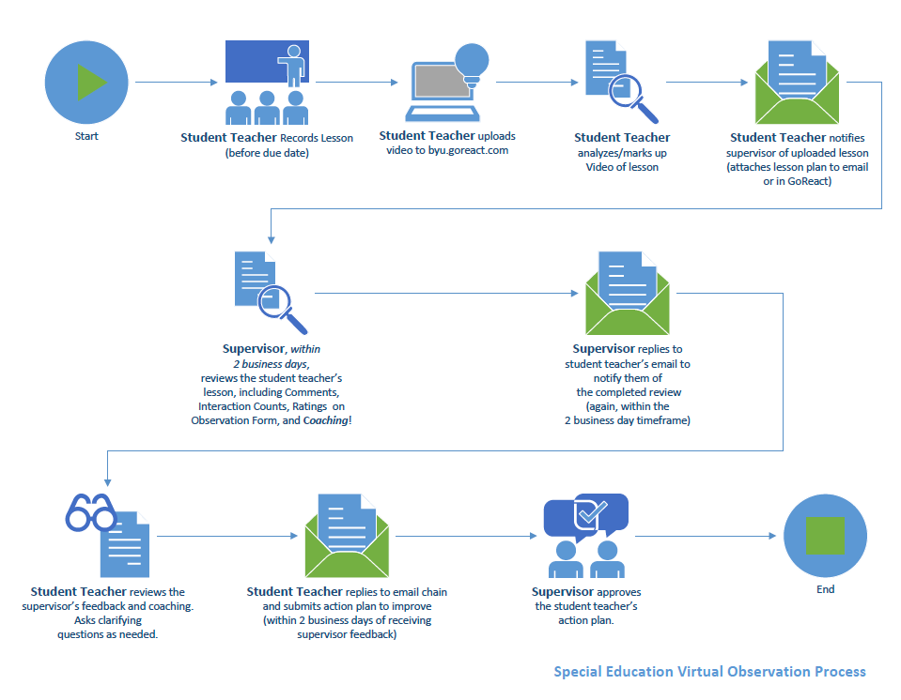

Slide 10
Workshopping Time
Consider how you could encourage your students to reflect and engage in the stages of the self-directed learning cycle (metacognition)?
  I.E. Planning, Executing, Monitoring, and Evaluating
Write down your thoughts
(if there’s time, we’ll share)
Please wrap up
1
minutes
2
minutes
3
minutes
4
minutes
5
minutes

Slide 11
“When I asked him what it was that allowed him to almost intuit the right answer to the problem, he replied, “It takes good judgment.”
“And how do you acquire good judgment?” I asked.
“Good judgment,” he said, “comes from experience.”
“Then, after pausing for just a few seconds and with only a hint of a smile, he added, “And experience comes from bad judgment.”
Kevin J. Worthen, Successfully Failing: Pursuing Our Quest for Perfection, January 6, 2015

Slide 12
Fixed Mindset vs. Growth Mindset
Set/unchangeable
Shows I’m not smart
Shows I am not good at this
I don’t like this…
They’re just lucky or naturally
good at this
Intelligence
Effort
Failure
Feedback
Success of
Others
Expands with effort (neuroplasticity)
Necessary to grow/get better
Part of the learning process
This is helpful to my progress
I can learn from how they did it

Slide 13
Workshopping Time
Brainstorm ideas on how you can support the interns to develop more of a growth mindset perspective?
  Elements of reflection assignments?
  Part of orientation materials or seminars?
  Other?
Please wrap up
1
minutes
2
minutes
3
minutes
4
minutes
5
minutes

Slide 14
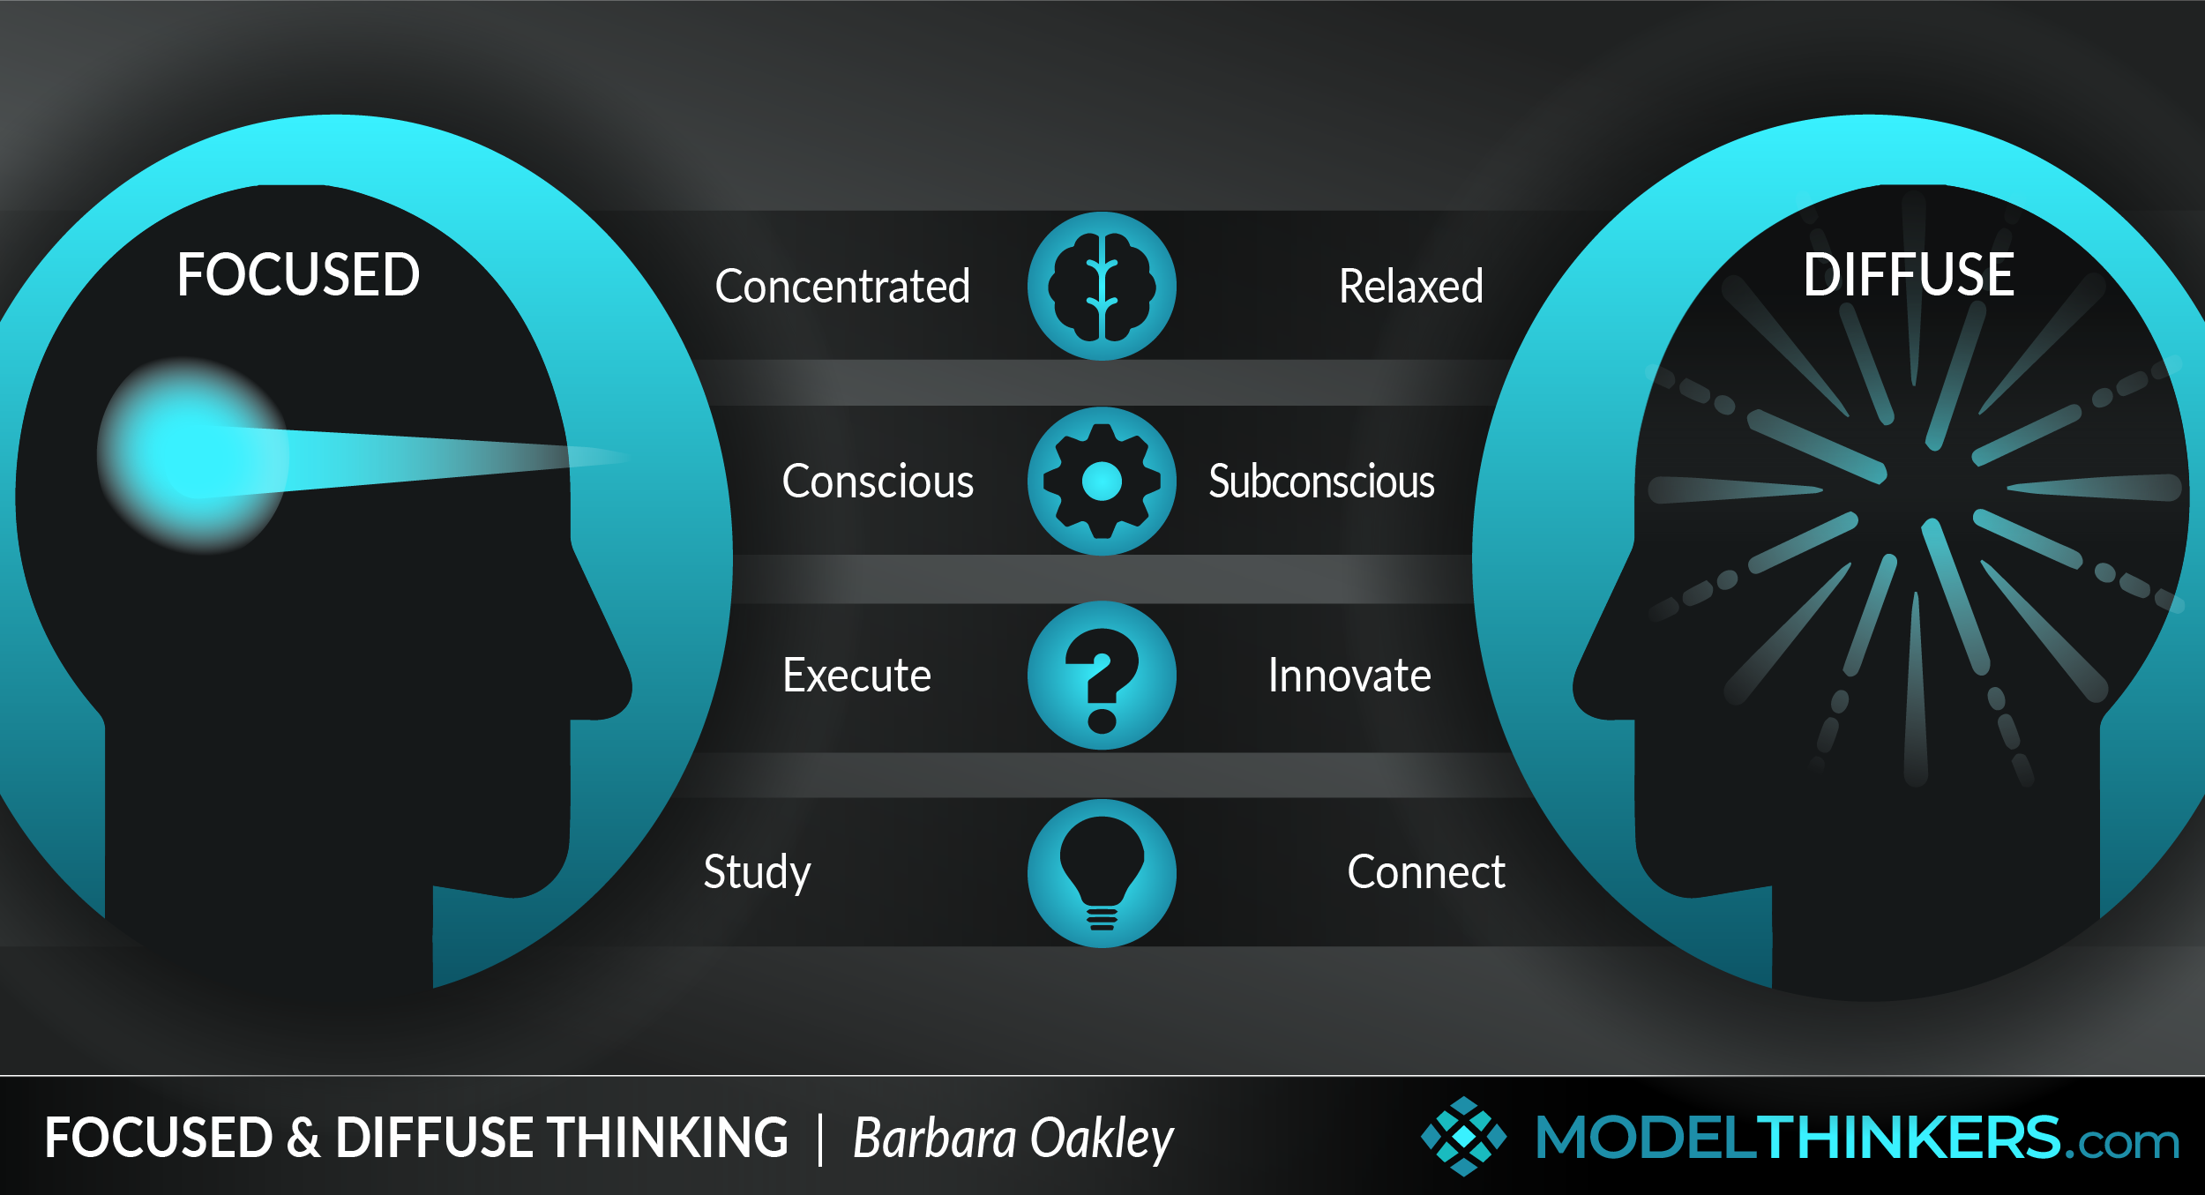

Slide 15
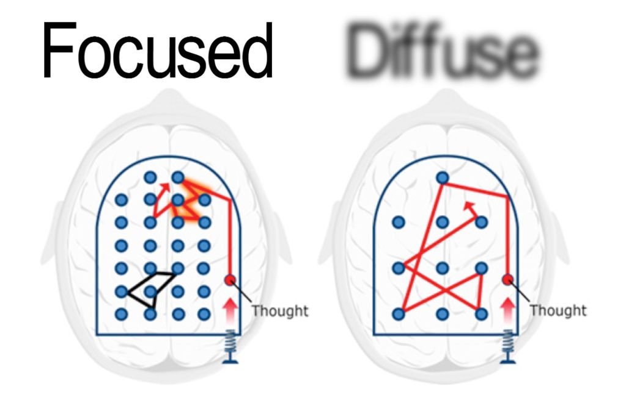
Focused vs Diffuse Modes of Thinking

Slide 16
Ways to Move to a Diffuse Mode of Thinking
Active break
  Walk
  Dance
  Other movement
Meditation
Pomodoro Technique
Sleep
Etc.

Slide 17
Putting it All Together
Effective Learning Outcomes
Valid
Assessments of Learning
Quality Learning Activities

Slide 18
References
Ambrose, S.A., et al (2010). How Learning Works.
Dweck, C. (2007). Mindset: The New Psychology of Success.
Oakley, B., Rogowsky, B., Sejnowski, T. J. (2021). Uncommon Sense Teaching.
Schön, D. (1987). Educating the Reflective Practitioner.
Worthen, K.J. (2015, Jan 6). Successfully Failing: Pursuing Our Quest for Perfection. BYU Devotional.

