Slide 1
Assessing Disciplinary Knowledge
& Professional Skills in Experiential Learning
Bill Heinrich, PhD
Orbis , Mindset
Twitter @billhridesbikes
March 12, 2021 BYU/LX Experiential Learning Summit-Panel
Notes:
Background
Chicagoland, Plumbing
Northern Illinois University
Psychology
Student Affairs
Michigan State University Student Affairs Administration
UC Santa Cruz
Outdoor Education
Outward Bound
Ski Bum®
NOLS
This is relational, how you see me helps you understand some of the assumptions I make
Assessment, Co-Curricular, & Organizations
MSU Higher, Adult, and Lifelong Education
The Hub for Innovation in Learning and Technology
USAID, Innovation Scholars Program
Scaling
Orbis,
Scholarship,
Leadership
Is thought leadership like being a social media influencer?

Slide 2

Notes:
We're a technology and innovation company with over twenty years of success in higher education, experiential learning, and student career readiness.​
​
We help every post-secondary graduate, our partner institutions, & communities reach their potential.

Slide 3
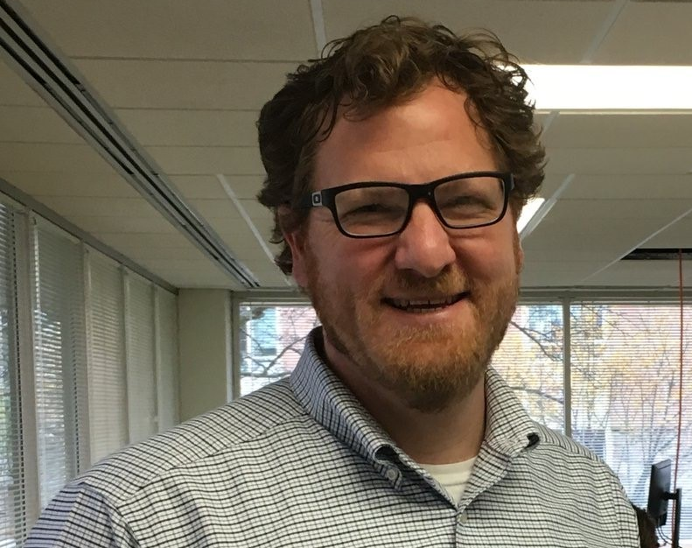
Bill’s Notes for Experiential Learning Assessment
Seriated Data & Reflections
Holistic Prompts
Consider the ‘Grain Size’
Intended and Emergent Outcomes
Feedback Rich

Slide 4
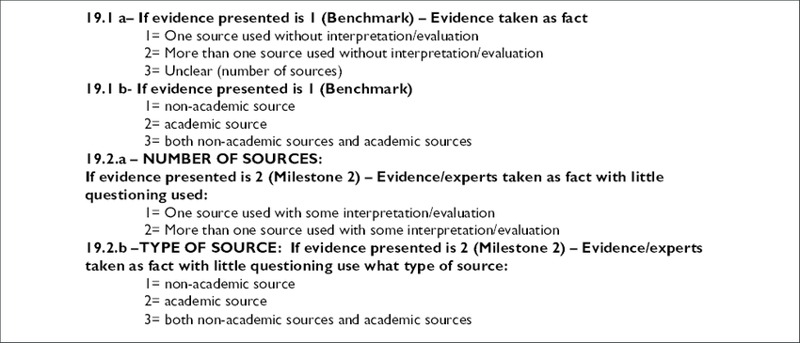
Assessing Critical Thinking

Slide 5
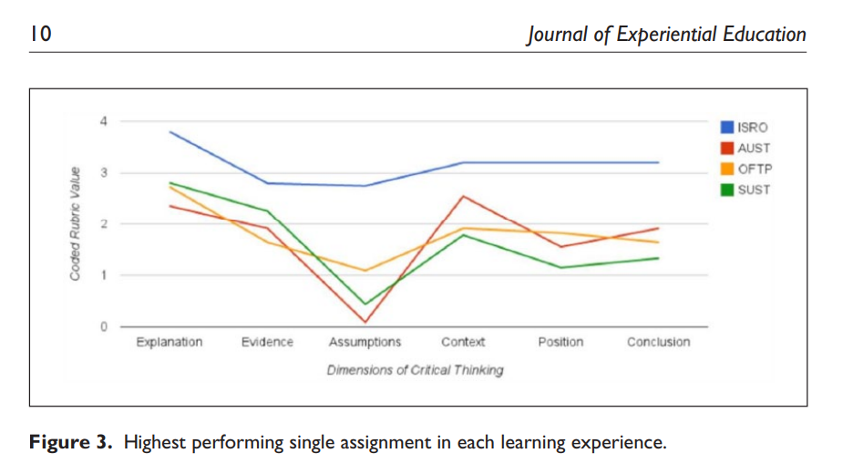
Assessing Critical Thinking

Slide 6
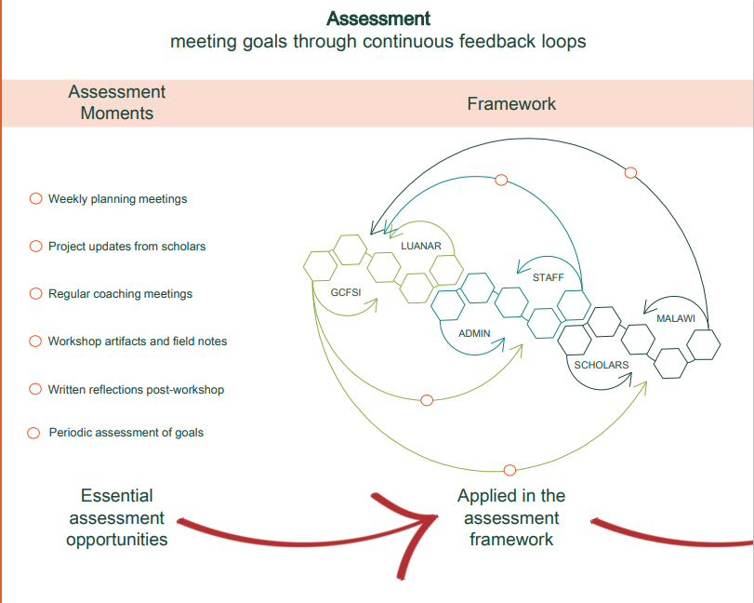
Assessing Mindsets for Design Thinking

Slide 7
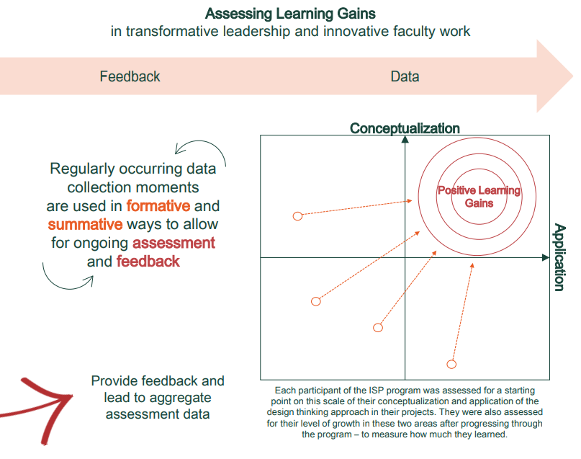
Assessing Mindsets for Design Thinking

Slide 8
Assessing Integrated Learning
Type of Assessment | Student outputs
Reflective Learning | Visible recursive thinking about process and content; development record during and after course
Network Analysis | Relationships, strength of collaborations, learning partnerships, teams, during and after course
Deliverables & use of feedback | Actual project solution, prototype, model, sketches, 3D prints, slide deck, pitch
Notes:
Integrated experiential learning takes the essential aspects of experiential learning and explicitly situates it in interdisciplinary course work and meaningful student engagement (Fenton & Gallant, 2016). We interpret IEL to mean learning through reflection on experiences that engage deep knowledge in broad applications and span co-curricular and curricular environments

Slide 9
References
Heinrich, W., Habron, G., Johnson, H., & Goralnik, L. (2015). Critical thinking assessment across four sustainability-related experiential learning settings. Journal of Experiential Education, (38). pp 373-393.
Heinrich, W. F., Cherchiglia, L., Abalo, T. R., & Bonnell, J. R. (2019). Learning to Innovate: A Case Study of Malawian Faculty Improving Food Systems with Human Centered Design. International Journal, 5(1), 225-241.
Heinrich, W. F., McCarthy, S., Ludwig, P., Swayne, N, Lewis, E., & Louson, E., (Forthcoming). Testing Assessments of Integrated Experiential Learning in ​Applying Design Thinking to the Measurement of Experiential Learning. ​Adam Peck and Danielle M. DeSawal, eds. IGI Press.​

