Slide 1
Assessing Disciplinary Knowledge as Professional Skills

Slide 2
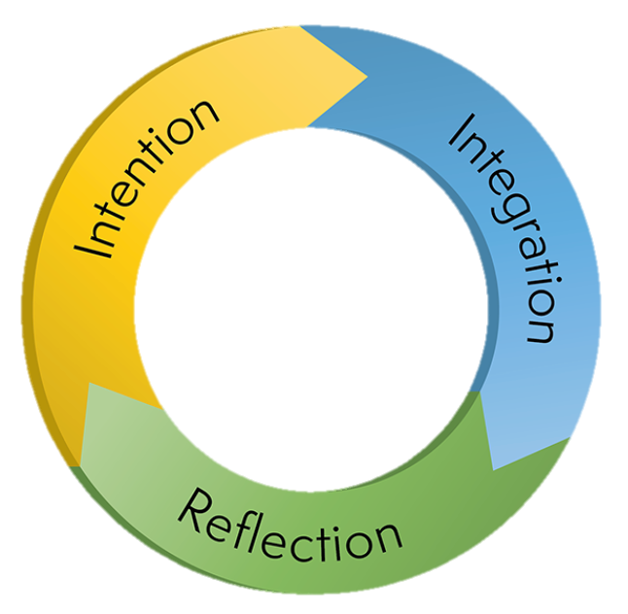
THE FORMULA
ExL Literacy + Competencies = Career Readiness
Experiential Learning Cycle
Humanities Competencies
Communication
Information Literacy
Cultural Navigation
Experience

Slide 3
Applying the Formula
Secondary Experience Curriculum
Intention—Outcomes
  Situating within course of study
Integration—Framing Assignments
  Aligning and Scaffolding
Reflection—Assessment
  Evidence-based narrative
    Understanding Competencies in Context
    ExL literacy

