Slide 1

Tapping Outside Funding Resources
Jaynie C. Mitchell, MA, EdD(ABD)
Grant Administrator

Slide 2
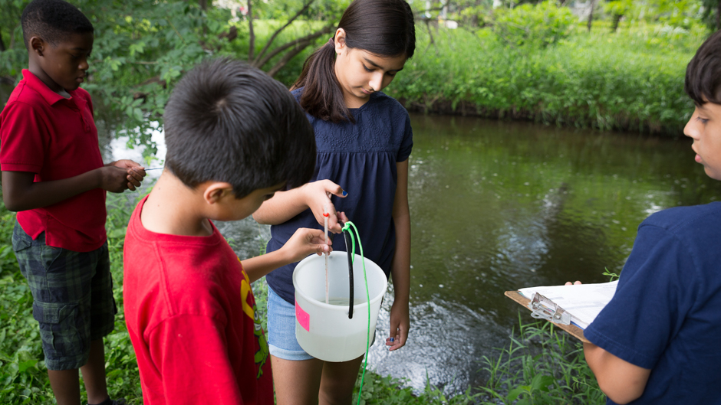
Tell your “student-centered” experience-based story
Follow a logical progression
Current Situation
Your Solution
Benefits to the population and broader community
This Photo by Unknown Author is licensed under CC BY-SA

Slide 3
Fundable Ideas
Are unique, interesting, and action-oriented
Meet a definite need or gap in the research
Have a broad appeal
Move your field forward
Make sense to non-experts
Are feasible in scale and scope

Slide 4
Finding Funders – Match is Key!
Clearly determine your:
Population of interest
Funding needs
What you have to offer
Funding timeline

Slide 5
Research who funds projects in your field
Look
Look at recent literature for funder information
Talk
Talk to others in your field
Check
Check your professional organization website for resource links
Consider
Consider opportunities for internal “seed funding” from your institution

Slide 6
Learn all you can about the funder’s…
Vision, mission, and strategic plans
Projects that have been funded
Funding opportunity – read guidelines carefully
Contact the program officer to ask if your project fits their interests

Slide 7
Online Funding Search Resources
Free Sites
Grants.gov http://grants.gov/
The Catalog of Federal Domestic Assistance (CFDA) www.cfda.gov
Federal Register http://www.gpoaccess.gov/fr/
Association, Foundation, Company websites
Subscription Sites – check with your institution
Pivot Pivot.proquest.com
Foundation Directory Online https://fconline.foundationcenter.org
Grantsmanship Center http://www.tgci.com/
GrantsNet http://www.grantsnet.com
GrantStation https://grantstation.com/
Guidestar http://www.guidestar.org

Slide 8
Examples of Funding Opportunities
Federal Funders grants.gov
National Science Foundation
19-582 Research Experiences for Undergraduates (REU)
Institute of Education Sciences
FY 2021 84.305T Transformative Research in Education Sciences Grants Program
National Institutes of Health
PAR-20-236 Providing Research Education Experiences to Enhance Diversity
Department of Health and Human Services
PAR-19-197 Summer Research Education Experience Program
Foundations
Arthur Vining Davis Foundation STEM Education https://www.avdf.org/grant-seekers/apply-for-grant/
Earthwatch.org Field Research Funding https://earthwatch.org/research/apply-for-research-funding
Professional Associations
North American Society for Sport Management (NASSM) Service Learning Grant Program https://www.nassm.com/Awards/ServiceLearningGrant
American Philosophical Society – Lewis and Clark Fund for Exploration and Field Research (Doctoral) https://www.amphilsoc.org/grants/lewis-and-clark-fund-exploration-and-field-research

