Slide 1
Scaling Experiential Programs at BYU-H
Creating Industry and University Relationships to grow
On Campus Internships (OCI)

Slide 2
Growing EL Programs Through Relationships
Experiential Learning Leaders
Relationships &
Word of Mouth
Industry Partners
Student Participants

Slide 3
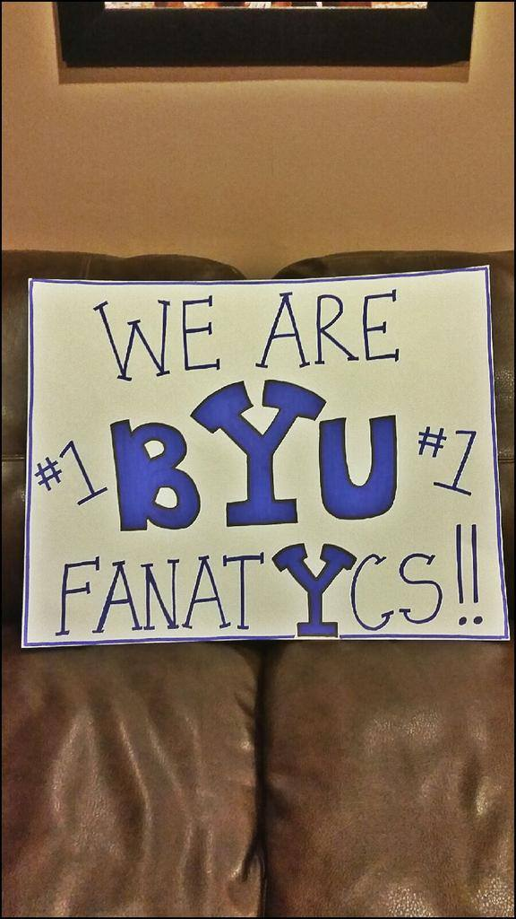




Building Industry Relationships
Steps to Viral Sponsor Growth
Start with your fans
Create Win/Win/Win relationships
Upgrade tasks to decisions or actions
Speak their language
Monetize your partners

Slide 4
Increasing Student Participation
University resources
Student Engagement
University/Academic Advisement
Career Center Advisors
Internship Coordinators
Experiential Learning Department
Curriculum Committees
Faculty
College Dean
Capstone Programs
Word of Mouth
Alumni of the programs
Industry Partner recommendations
Student Clubs
Faculty class recommendations
Social Media
Student Bulletins
Paid Advertising (Posters, Cafeteria, etc.)

