Slide 1
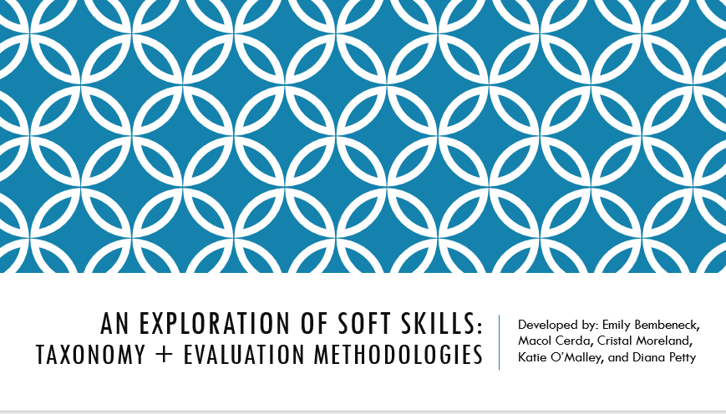

This work exists thanks to Nat Grotte.
And with ENORMOUS thanks to the Chicago Booth Executive Program for Emerging Leaders (EPEL) team that tackled it:
Emily Bembeneck
Macol Cerda
Cristal Moreland
Katie O’Malley
Diana Petty
Connecting Project-Based EL
Outcomes To Workplace Skills
Research study - Phase 0
Preliminary Literature Review
Notes:
This will be year 3

Slide 2
Preliminary Literature Review
Connecting Project-Based EL to Workplace Skills
Situation
We’ve been interested in conducting a research study to assess the extent to which project-based learning develops the soft skills that employers seek (in discussion since LEPE 2017)
Complication
How should we go about doing this?
Got stuck on the research outline; having trouble narrowing the scope and zeroing in on approach
Some fundamental questions unanswered: No comprehensive sense of work already done on this subject
Key Questions
Is there an agreed upon taxonomy of “soft skills” that MBA programs should use?
Are there existing best practices for evaluating and assessing soft skill development – in academia or industry – that can be built upon for use with MBA students?

Slide 3
Approach
SOURCES
Soft Skills Taxonomies | Soft Skills Evaluation/Assessment
Top tier consulting firms: Deloitte, McKinsey, BCG HBR content on “soft skills” Google scholar searches: “consulting industry”, “soft skills”, +/- interpersonal skills”, +/- “definition”, “taxonomy”, “evaluation” Bibliographies of top-cited, recent papers (>2013) Sage, Taylor, & Francis related articles | University of Chicago libraries & Google Scholar Full text Peer reviewed Published within ten years, ideally five International Search terms: “business education”, “graduate program”, “soft skills”, “assessment”, “evaluation”, learning outcomes
4 LENSES
1. Business education
Higher education
Talent development
Leadership development

Slide 4
Findings (some highlights)
Plenty of opportunity for LEPE to contribute to the discussion
TAXONOMIES
EVALUATION & ASSESSMENT
No agreed upon taxonomy in academic literature
No “soft skill” taxonomies were offered on the public sites of Deloitte, McKinsey, or Boston Consulting Group
Consensus on the need for more focus on soft skills in higher education
Varied terminology for “soft skills”, and many alternatives are commonly used:
  21st Century Skills
  Emotional Intelligence or EQ
  Generic competencies
  Key competencies for lifelong learning
  Transferable skills
  Interpersonal skills
Debate around the notion of soft skills as “skills” as opposed to sets of behaviors and/or actions.
No silver bullet when assessing soft skills
Self-assessment, simple rating scale: the predominant method
Ratings by another person: a more accurate alternative to self-rating scales
Utilize both quantitative and qualitative methods
Numerical scales can be useful, but accuracy depends on understanding of concepts behind the numbers, availability of large data sets and validation
Rubrics often cannot capture all or even most of such a complex construct (soft skills)
Notes:
From Industry research – note here:
Most of publicly available content discussing skills focused on: leadership, 21st century skills (ex. adapting to artificial intelligence and/or gig economy), and talent management from a team-based approach
Much of material also discussed emotional intelligence or emotional learning, as opposed to “soft skills”

Slide 5
Implications for our Study – Next steps
Project Plan Outline
Executive Summary
Statement of Need
  Purpose of study
  Necessity of research
  Challenges to solve (targeted research questions)
  Literature Review (Booth-EPEL study)
Identify participating organizations
  Landscape analysis
  SWOT
  Compare and contrast SWOTs
Project charter
  Purpose, justification, value add
  High level description
  Measurable objectives and success criteria
  High level deliverables
  Requirements
  Risks
  Constraints
  Milestones/schedule
  Timeline
  Key stakeholders
  Approval requirements
  Resources required
  Budget summary
Questions we need to consider:
Parameters of what constitutes “experiential learning” – e.g. project-based vs. other types
Population(s) to focus on
Unit of measure for evaluation (single class, MBA program on the whole, a few years post-graduation)
Targeted skills intended to be developed

Slide 6
Suggestions for next phase of research based on key decisions
    Comparative analysis of each LEPE program’s behavioral self-assessment for incoming students - could point to key commonalities to build taxonomy/experiential learning parameters
    Survey what other MBA programs are doing on experiential learning assessments
    Comparative analysis of "soft skill" versus "emotional intelligence" definitions in literature
    Deeper dive into "direct assessment" methodologies
For more detail on this study:
Nathaniel.Grotte@chicagobooth.edu

