Slide 1
Using Writing to Prompt Reflection by Interns
Trina Harding, English Internship Coordinator
John Bennion, Experiential Writing Teacher

Slide 2

experientialwriting.byu.edu

Slide 3

Learner outcomes:
Discipline or Industry Specific Skills and Knowledge
Transferable Competencies and Knowledge
Experiential Learning Literacy – “Life-long Learning”

Slide 4
Guided reflection exercise
What are 3-5 problems your students face as interns? Prioritize.
What are 3-5 problems you face as an internship coordinator? Prioritize.
Reflect for a minute in writing on how these two lists affect each other.
Pick one problem your students face and, without trying to immediately solve the problem, reflect on what you might learn about the structure of internships you manage, the diverse kinds of experiences your students are having, and what results you would like to have.

Slide 5

What are 3-5 problems your students face as interns? Prioritize.
What are 3-5 problems you face as an internship coordinator? Prioritize.
Reflect for a minute in writing on how these two lists affect each other.

Slide 6
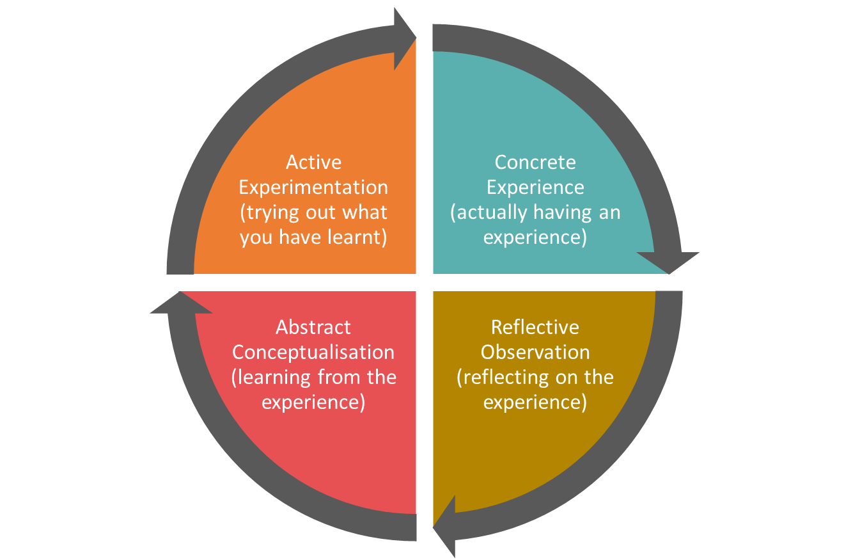

Why Reflection?
Reflection is “active, persistent, and careful consideration of any belief or supposed form of knowledge in the light of the grounds that support it and the further conclusions to which it tends” (John Dewey, How We Think: A Restatement of the Relation of Reflective Thinking to the Educative Process, 1933).
Experiential Learning Theory (Kolb, 2005)
BYU Office of Experiential Learning and Internships: Cycle of Inspiring Learning

Slide 7
Why Reflective Writing?
Reflective writing “is how we make our learning visible to ourselves . . . constructing a coherent narrative is how, in fact, we learn” (Clark and Rossiter, 2008, p. 66).
Students who repeatedly engage in structured reflection as part of experiential learning are more likely to bring a strategic learning orientation to new challenges (Eyler 1993; Eyler and Giles 1999)
“Reflection is the element that transforms simple experience to a learning experience” (National Society for Experiential Learning)

Slide 8
Establishing a Framework of mentoring interns
Mentored (throughout the process)
Recursive
Adaptable

Slide 9
EL is mentored learning:
Kirschner et al. (2006) write that many experiential educators believe that students best learn through unmediated experience. However, their study concludes that successful experiential educators provide scaffolding by modeling, contextualizing, and dialoguing with participants during the experience.

Slide 10
Mentors provide scaffolding that creates intention
Heinrich et al. (2015) used reflective writing to help students synthesize what they learned. Evaluation of their writing showed that strong outcomes came from properly scaffolded instruction.

Slide 11
The mentor and the intern create a small community:
Reflection is a social activity, one enabled by speaking and writing (Seaman & Rheingold, 2013). Dewey and Vygotsky long ago described the symbiotic relationship between individual and social construction of meaning (Dewey, 1916, 1925; Glassman, 2001; Vygotsky, 1934).

Slide 12
Reflection is a recursive process
Seaman (2008) concludes that, if learning is synchronic, spontaneous, and complex, any curriculum that dogmatically relies on the Kolb Cycle sequence might miss taking advantage of the rich and holistic nature of human experience by focusing on its individualistic, mechanistic, and rationalistic aspects.

Slide 13
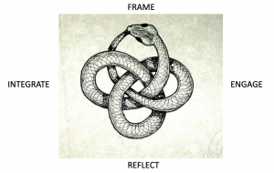
Recursive

Slide 14
Adaptable
Mentoring and reflection experiences must adapt to
Varieties of experiential programs:
adventure/wilderness therapy,
internships, study abroad/field study,
experiential classrooms,
business organizational development

Slide 15
Varieties of internships:
science labs,
international programs,
on-campus internships,
off-campus work, and
practicums

Slide 16
Varieties of individuals and individual experience:
∞

Slide 17
Creating Intention
Foster student autonomy and buy-in
Students should understand the why of both the experience, AND the purpose and personal benefit of the reflection process in the course.
Students should then be able to articulate the value they hope to gain from of the experience.
Students should experience a sense of autonomy in this intention process as well as throughout the experience.
Self-determination theory (Ryan and Deci, 2000)
Agentic Learning (Yanchar, 2011; Yanchar and Spackman, 2012)

Slide 18
Prompting Reflection
Specific yet flexible prompts that allow for personally meaningful responses.
MEANING
Writing what the professor wants me to say
Writing whatever pops into my head
Our job is to create the space and provide the support to allow the best opportunity for students to create meaning.

Slide 19
Prompting Reflection
Specific yet flexible prompts that allow for personally meaningful responses.
Writing what the professor wants me to say
Writing whatever pops into my head
Consider writing about (list several options)
Talk about how you are progressing toward the goals you have set. Adjust your goals as necessary.
Look for connections between the work you are doing, the culture you are immersed in, and the literature you are reading.

Slide 20
Narrative Framework
Always has an audience, real or imagined
“Has work to do” (p. 4), or is written for a purpose
Follows a story structure
Adds details (color, spice, texture) to the story
Focuses on a specific event (though may certainly draw in additional events as support).
I love these assignments, and think about them often throughout the weeks. . . .This class has been so fulfilling and enriching.
(Fall 2019-Scottish Parliament Intern)

Slide 21
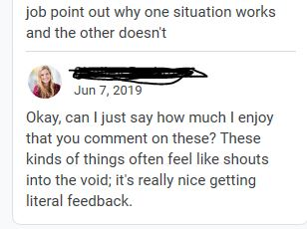
Feedback
Writing what the professor wants me to say
Writing whatever pops into my head
Ask follow-up questions that they can address next time.
“This is an interesting way of thinking about this problem. You might consider exploring this more in your next report especially since you may find yourself in a similar situation in the future.”
Connect with what they have shared on a personal levela
“I always felt like I could give my full opinion because you always are so vocal about thoughts and responses. We all super appreciate it! We’d be like, ‘Trina wrote comments!’ like it was the mail on P-Day.”

Slide 22
Integration
This reflective process is integral to all phases of experiential learning, from identifying intention and choosing the experience, to considering preconceptions and observing how they change as the experience unfolds. (National Society for Experiential Education, 1998)

Slide 23
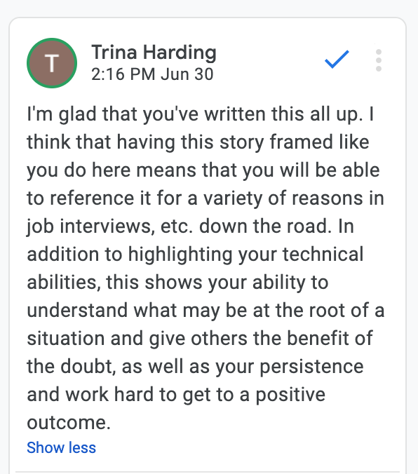
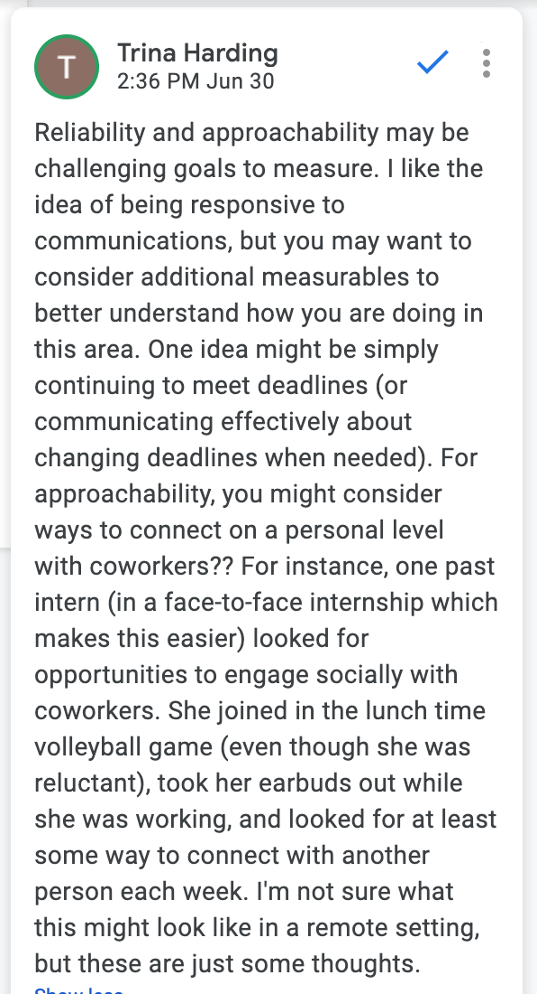
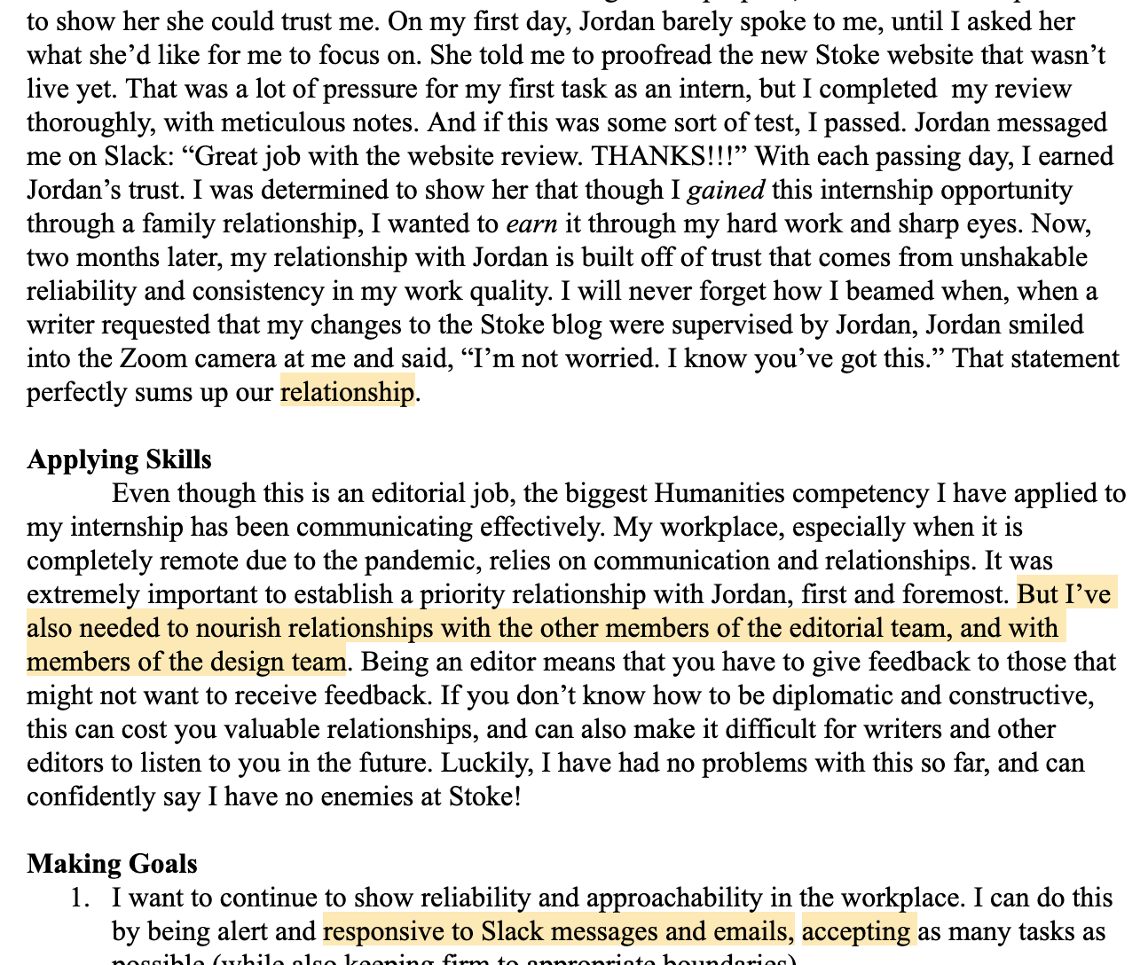
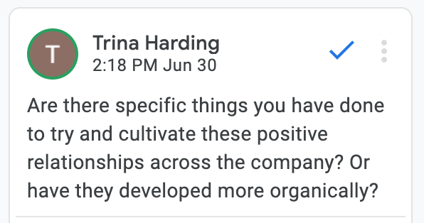

Slide 24
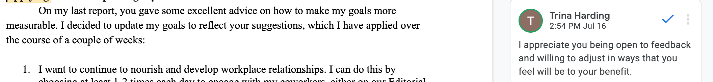
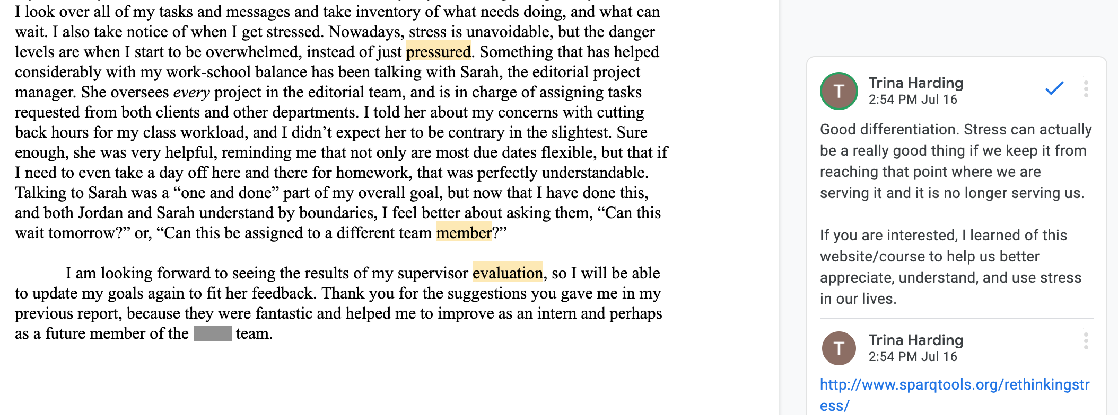

Slide 25
Evaluation
Reflection is also an essential tool for adjusting the experience and measuring outcomes.
(National Society for Experiential Education, 1998)

Slide 26

Ultimate integration

Slide 27
Revisit reflective writing exercise:
What did you learn about solving one problem?
How might guided reflective prompts help?

