Slide 1

Experiential Learning Summit Series:
Challenges and Solutions for Online

Slide 2
November Summit Series
Demonstrating the Value of
Your Experiential Learning Efforts
November 13, 2020 11am & 1pm

Slide 3
Agenda
Welcome and Introductions 11:00am-11:05am
Andrew Allen, Director of the Magelli Office of Experiential Learning
Panel Presentations 11:05am-11:20am
Dr. Michellana Y. Jester, Lecturer and Course Faculty Lead, MIT Sloan School of Management
David Comisford, CEO of EduSourced
Panel Discussion 11:20am-11:55am
Moderated by Andrew Allen, Director of the Magelli Office of Experiential Learning

Slide 4


Slide 5
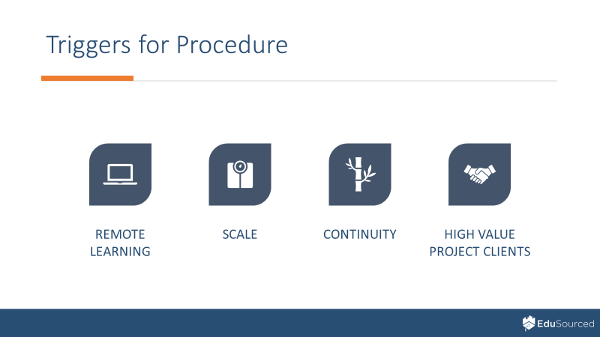

Institutional Support of Experiential Learning
(in a remote learning world)

Slide 6

Institutional Support of Experiential Learning
(in a remote learning world)

Slide 7
November Summit Series
Demonstrating the Value of
Your Experiential Learning Efforts
November 13, 2020 11am & 1pm

