Slide 1

Experiential Learning Summit Series:
Clarifying the Transferable Skills

Slide 2
Agenda
Welcome and Introductions 1:00pm-1:05pm
Dave Waddell, Director of Experiential Learning & Internships at BYU
During the meeting, please provide the breakout room topic you would like to participate in based on the list of categories below in the Chat feature.
Break out room topics:
What are Skills vs. Behavior, How to Help Student Articulate Them, Especially when Experience is Different from the Job They are Applying for-Christine Miller: Moderator
Intentionality & Assessment of Transferrable Skills, Clarifying What they Are-Jeff Tessem: Moderator
How do we Engage Faculty in the Discussion about Transferrable Skills, Making it a Part of Curriculum, Etc.-David Habben: Moderator
Panel Discussion 1:05pm-1:30pm
David Habben, Assistant Professor at BYU
Christine Miller, Global HC Talent & Impact Team at PwC
Jeff Tessem, Professor at BYU
Weston Ellison, student at BYU
Breakout Session 1:30pm – 1:45pm
Breakout Session Findings 1:45pm – 1:55pm

Slide 3
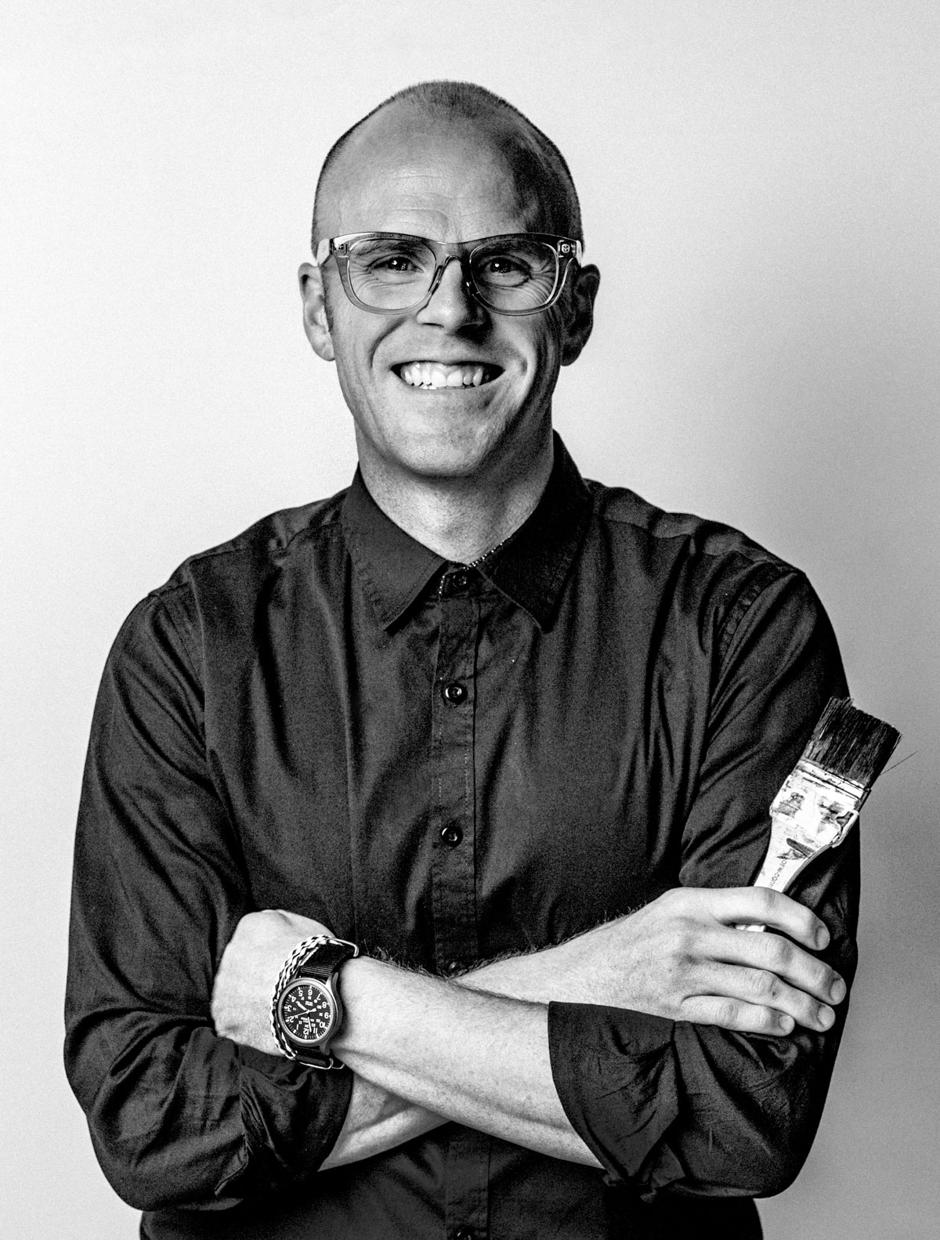
Transferable Skills from College to Career
Build Earned Confidence Through
Real World Experience
Apply foundational skills adaptively.
Find or create opportunities outside your field of study.
Reflect deeply on the experience.
David Habben
Asst. Professor of Illustration
Department of Design
Brigham Young University
About me:
BFA Illustration ‘06 Brigham Young University/
MFA Studio Art ‘18 University of Utah
Lucky husband and proud father of two
Loves to travel and be outdoors

Slide 4
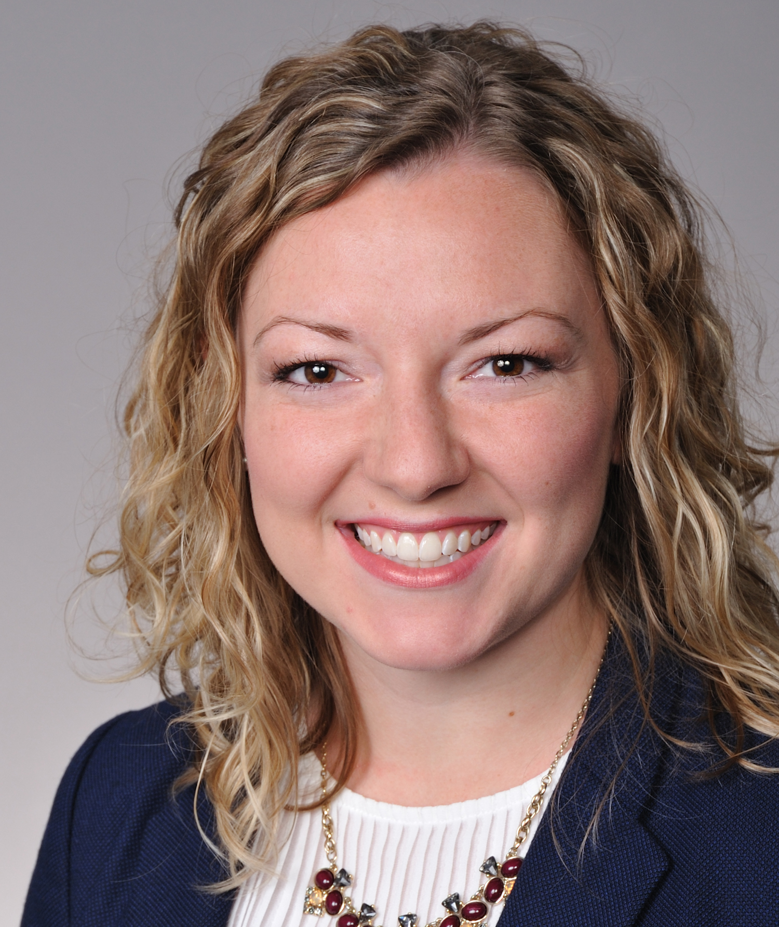


Transferrable skills from college to career
Top skills students learn through experiential learning and why employers care
Agility
Communication
Christine Miller, CPA
Global Human Capital Talent & Impact
PwC, Chicago
PwC Experience:
Global Human Capital
US Talent Acquisition
Client Service – Assurance
Teamwork
About me:
Moving to Switzerland June 2021
Avid traveller
Restaurant enthusiast

Slide 5
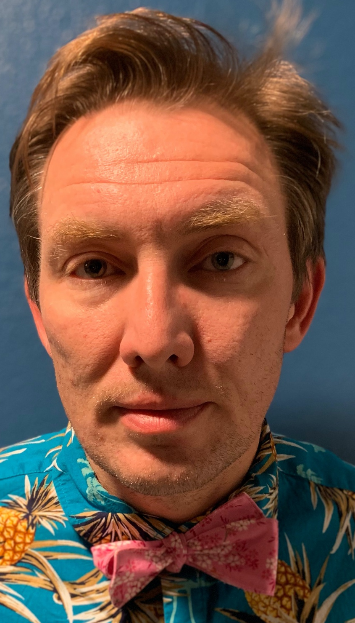
Transferable skills from college to career
Jeffery Tessem, PhD
Associate Professor of Nutrition Science
Brigham Young University
Education:
BS-Microbiology, BYU
PhD-Molecular Biology and Biochemistry, University of Colorado Anschutz Medical Campus
Postdoctoral Fellowship-Duke Medical Campus
About Me:
Wife Kathleen and I have four children
Runner and cyclist, working on improving swimming from controlled drowning.
Like to bake sourdough bread and make salsa and pickles.
Define the underlying principle
  What is the hypothesis?
  Scientist or Technician?
  Blocked or interleaved practice?
  Kind or wicked learning environment?

Slide 6
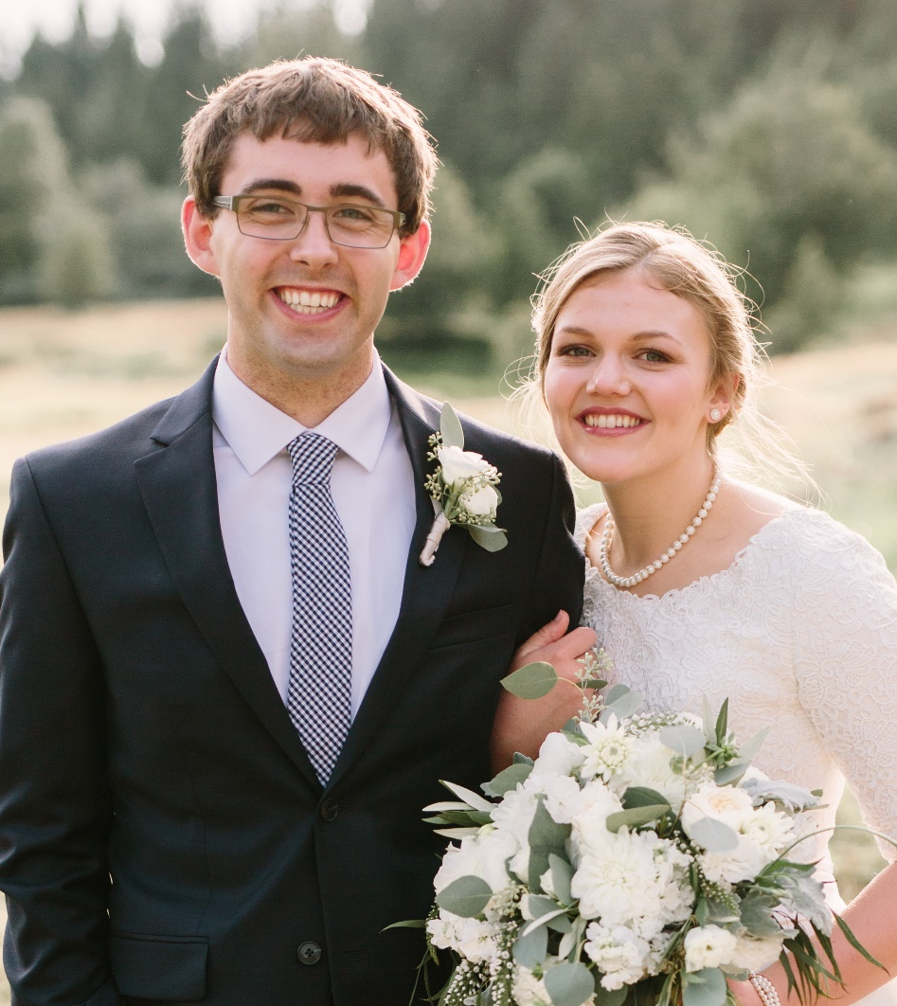
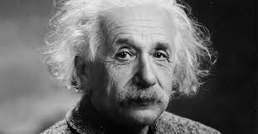
Transferable skills from college to career
Weston Elison
Research Assistant – Tessem Diabetes Research Lab
Senior – BYU
Education:
Major: Physiology and Developmental Biology
Minor: Computer Science
About Me:
Baby girl expected January 2021
Hobbies: Backpacking, camping, and eating
Independent Thinking
“If a person masters the fundamentals of his subject and has learned to think and work independently, he … will better be able to adapt himself to progress and changes than the person whose training principally consists in the acquiring of detailed knowledge.” – Albert Einstein, Ideas and Opinions, pg. 64
https://www.snopes.com/fact-check/driver-switches-places/

Slide 7

Transferable Skills
Christine Miller, Human Talent and Impact, PwC Top skills students learn through experiential learning and why employers care Agility Communication Team Work | David Habben, BYU Professor of Art Build Enhanced Confidence through Real World Experience Apply foundational skills adaptively Find or create opportunities outside your field of study Reflect deeply on the experience
Jeff Tessem, BYU Professor of Nutrition and Dietetics Define the underlying principle What is the hypothesis? Scientist or Technician? Blocked or interleaved practice? Kind or wicked learning environment? | Weston Elison, BYU Student Independent Thinking “If a person masters the fundamentals of his subject and has learned to think and work independently, he … will better be able to adapt himself to progress and changes than the person whose training principally consists in the acquiring of detailed knowledge.” – Albert Einstein, Ideas and Opinions, pg. 64

Slide 8
Breakout Rooms
Skills vs. Behavior
Intention & Assessment
Engaging Faculty

Slide 9
