Slide 1

Experiential Learning Summit Series:
Managing Student Teams

Slide 2
Agenda
Welcome and Introductions 11:00am-11:05am
Dave Waddell, Director of Experiential Learning & Internships at BYU
During the meeting, please provide the breakout room topic you would like to participate in based on the list of categories below in the Chat feature.
Breakout Room Topics:
Managing from a Distance: Communication, Accountability, Organizing Work, Leadership, Training, Software Solutions, Etc. –Arline MacCormack, Moderator
Student Performance Assessment that Leads to Improvement-Ali Crandall, Moderator
Balancing Productivity with Cheerleading, Your Needs vs. Theirs, Etc.-Scott Steffensen, Moderator
Panel Discussion 11:05am-11:30am
Ali Crandall, Assistant Professor at BYU
Kirsten Novilla, student at BYU
Arline MacCormack, Associate Director of Experiential Education at Babson College
Scott Steffensen, Professor at BYU
Breakout Session 11:30am – 11:45am
Breakout Session Findings 11:45am – 11:55am

Slide 3
Engaging the Unengaged
Strategies to Engage Students in Classroom and Research Settings
Ali Crandall, PhD MPH
Small teams
Everybody has an assignment
  Variety of meaningful tasks
Ensure clear vision
Student ownership of projects
Course teams: option of “firing” students for non-performance
Research: student completes introductory research modules before joining lab
Research Interests:
  Families and health
  Childhood experiences and mental health
  Measuring family health

Slide 4
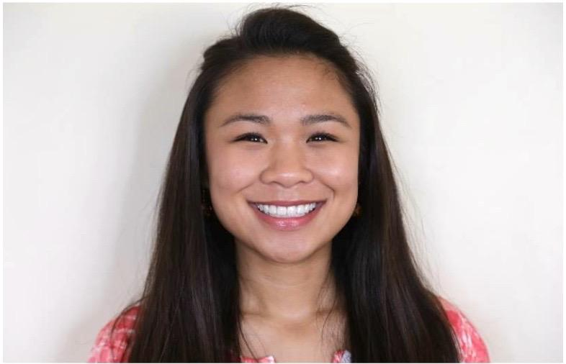
Creating a vision
Roadmapping
Setting Goals & Assigning Roles
Responsibilities & Expectations
Collaboration & Communication
Listening, Learning, & Improving
Kirsten Novilla
Undergraduate student in the Public Health program
Research assistant in the Brain, Family, & Health Lab
Teaching assistant in Health Systems and Policy
Experience in mentoring and team leading

Slide 5
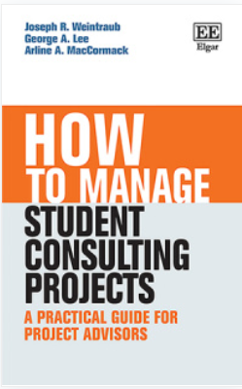
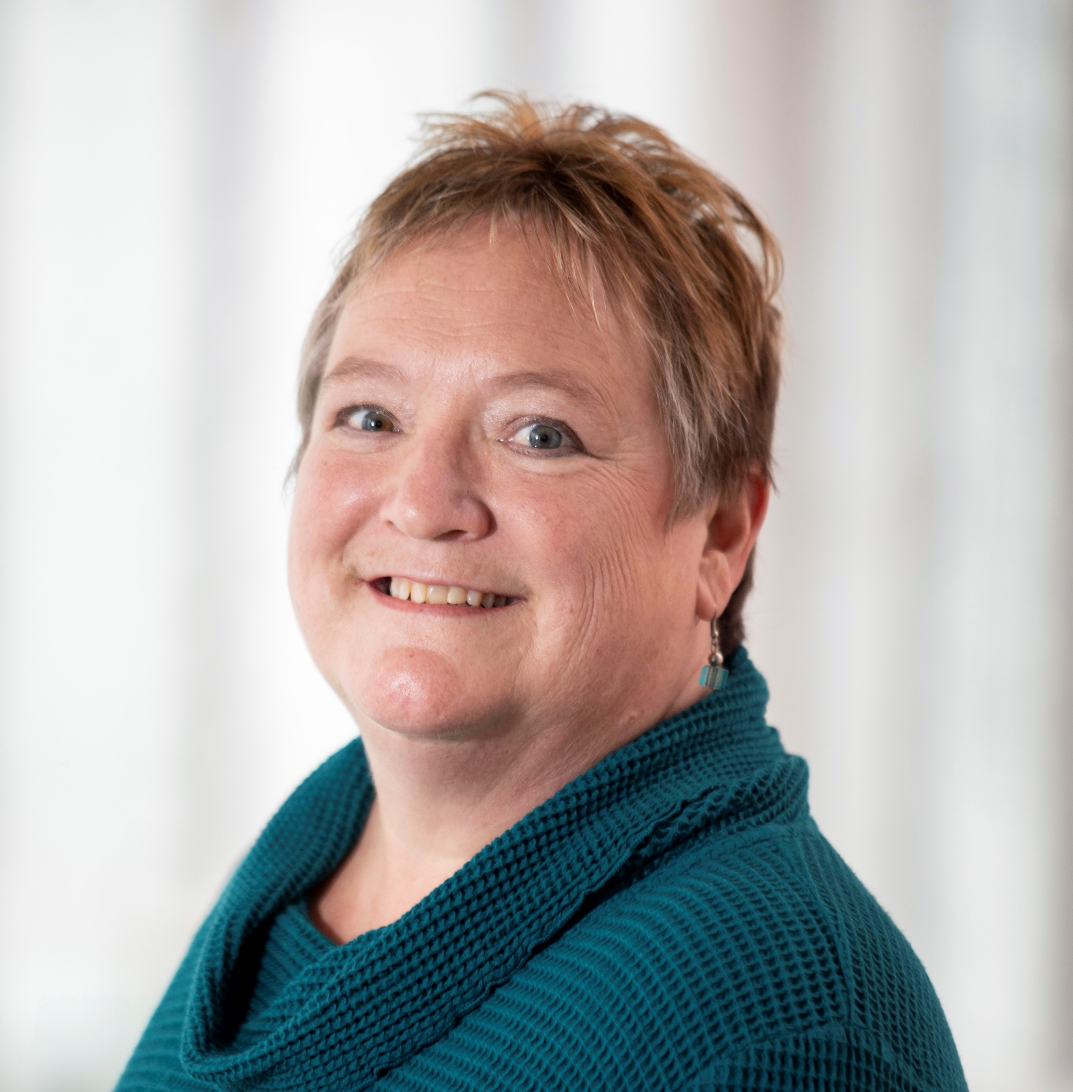
Managing Student Teams
Creating a Team Charter:
  Meeting Times
  Individual Roles
  Code of Conduct
  Individual Commitments
  Preparation/Participation
  Communication/Conflict
Arline MacCormack, M.A.
Associate Director, Experiential Programs
Babson College
Management Consulting Field Experience Program
Career Exploration Lab
Intern Sponsorship Program
Externship Program

Slide 6

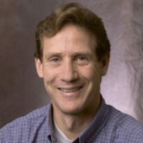
Scott Steffensen, PhD
Psychology, Neuroscience
Role of Grad Students in Managing and Mentoring

Slide 7
Working with Student Teams
Dr. Ali Crandall, BYU Professor of Public Health Strategies to Engage Students Small teams Everybody has an assignment Variety of meaningful tasks Ensure clear vision Student ownership of projects Course teams: option of “firing” students for non-performance Research: student completes introductory research modules before joining lab | Arline MacCormack, Associate Director of Experiential Programs, Babson College Creating a Team Charter Meeting Times Individual Roles Code of Conduct Individual Commitments Preparation/Participation Communication/Conflict
Dr. Scott Steffensen, BYU Professor of Psychology Resolving Conflict Spreading the mentoring load – grad students | Kirsten Novilla, BYU Student Creating a vision Roadmapping Setting Goals & Assigning Roles Responsibilities & Expectations Collaboration & Communication Listening, Learning, & Improving

Slide 9
Breakout Topics
Managing with Distance
Student Performance
Balancing Productivity

Slide 10

October 9th
Experiential Learning in a COVID-19 World
Challenges and solutions to ExL in a COVID world - managing from a distance, shrinking opportunities, maintaining quality mentoring, etc.
How ExL can enhance the value of a university education given the COVID disruption of the traditional campus experience.

