Slide 1

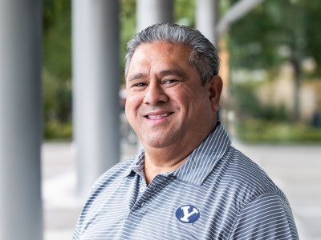
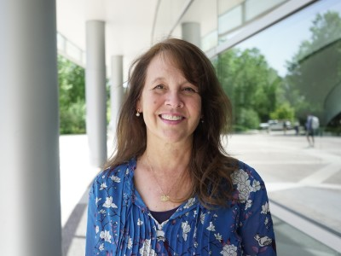

INTRODUCTIONS
Will Tenney
Director Recruiter Experience Team (RXT)
Beth Hiatt
Director Recruiter Experience Team (RXT)
Notes:
WILL –
I AM WILLIAM TENNEY A.K.A WILL I AM THE DIRECTOR FOR THE RXT TEAM WHICH IS A TEAM WITHIN THE CEL -– RXT STANDS FOR RECRUITER EXPERIENCE TEAM. OUR TEAM ENSURES THAT ANY EMPLOYER WHO COMES ON CAMPUS HAS AN EXCEPTIONAL EXPERIENCE AT BYU WHICH WILL THEN CONVERT INTO MORE OF OUR BYU STUDENTS GETTING HIRED AND GIVEN CAREER OPPERTUNITIES BY THESE REPEAT EMPLOYERS.
I WORK CLOSELY WITH THE STEM TEAM IN CEL.
Beth -

Slide 2

Why BYU Handshake?
643 Employers posted active jobs
20,847 jobs
700 internships
Notes:
WILL –
WE WANT TO SHARE NOW WHAT THE PROCESS LOOKS LIKE WHEN YOUR CLUB PARTNERS WITH CEL –
THERE WILL BE TWO TYPES OF CLUB REQUEST –
1ST IS A STANDARD CLUB REQUEST – MEANING JUST YOUR REGULAR WEEKLY MEETING OR GATHERING IF YOU NEED HELP WITH SECURING A VENUE ETC. OR THIS IS WHEN MORE THEN ONE CLUB WANT TO GET TOGETHER AND HAVE AN EVENT.
THE 2ND REQUEST IS FOR EXCLUSIVE FOR JUST THE CLUB MEMBERS ONLY AND HAVE A HIGH PROFILE PRESENTER – CEO OR VP OR WELL KNOWN PERSON.
I HAVE TO PUT A DISCLAIMER HERE THOUGH, ANY REFRESHMENTS OR FOOD ARRANGEMENTS WILL BE LEFT TO THE CLUBS TO ORGANIZE, WE DON’T DO FOOD, SORRY!
BOTH REQUEST WILL COME THROUGH OUR HANDSHAKE PLATFORM FOR EVENTS SO WE WILL SHARE HOW THAT IS TO BE DONE.
(NEXT SLIDE)

Slide 3
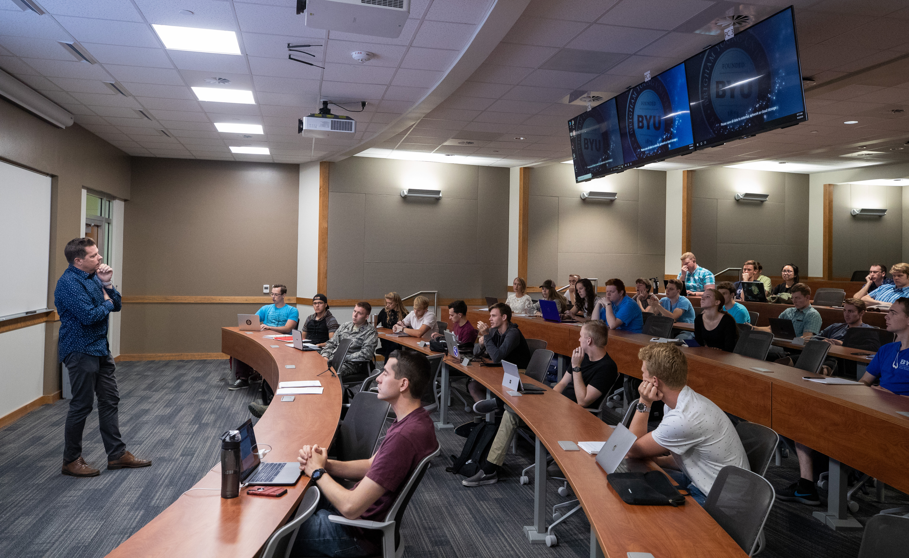
How To Use Handshake
View internships
Post internships from employers/contacts
Encourage employers/contacts to post internships directly
Notes:
BETH –
IF IT IS A VIRTUAL EVENT WE CAN SET UP ZOOM FOR YOU
MORE STUDENTS TO BE AWARE OF YOUR CLUB AND ALSO BE ABLE TO RPOMOTE YOUR CLUB WITH CD
WE CAN GET ATTENDEES WHETHER IT BE IN-PERSON OR VIA ZOOM WHICH WE SET UP FOR YOU.
1. FOR A WEEKLY CLUB MEETING DO YOU NEED TO NOTIFY YOUR ADVISORS FOR APPROVAL?

Slide 4

1. View Internships on Handshake
You will need to set-up a student account on Handshake
Use the link on Career Services website - Technology Request Handshake Account
Technology request, complete request and Tech team will get back to you
With your Handshake account you will be able to search Internships and see all the internships posted, use filters to be specific
Notes:
WILL – CAN I POINT OUT THAT THESE EVENTS CAN BE SET UP ETHER FOR IN-PERSON OR THEY CAN BE SET UP VIRTUALLY BY CEL. DEPENDING ON OUR CAMPUS POLICIES FOR GATHERINGS ETC SO KEEP THAT IN MIND.
THE SECOND REQUEST AS MENITONED ARE EXCLUSIVE CLUB EVENT TO CLUB MEMBERS ONLY AND THEY HAVE A HIGH PROFILE PRESENTER – CEO OR VP OR AGAIN SOMEONE WITH HIGH PUBLIC PROFILE (TOM CRUISE)
THESE WILL NEED TO GO THROUGH THE ACADEMIC VPS OFFICE – SO THESE REQUEST NEED TO BE SUBMIITED 48 HOURS BEFORE THE EVENT OR EVEN MORE.
SUBMITT THE REQUEST VIA HANDSHAKE
CEL WILL CONTACT CLUB LEADER TO CONFIRM THE REQUEST
CEL SUBMIT THE REQUEST TO BYU CLUBS
TENTATIVELY RESERVE ROOM
BYU WILL CONTACT CLUB ADVISOR TO CONFIRM EVERYTHING – SO JUST BE AWARE OF THAT ADVISORS. – (NEXT SLIDE)

Slide 5
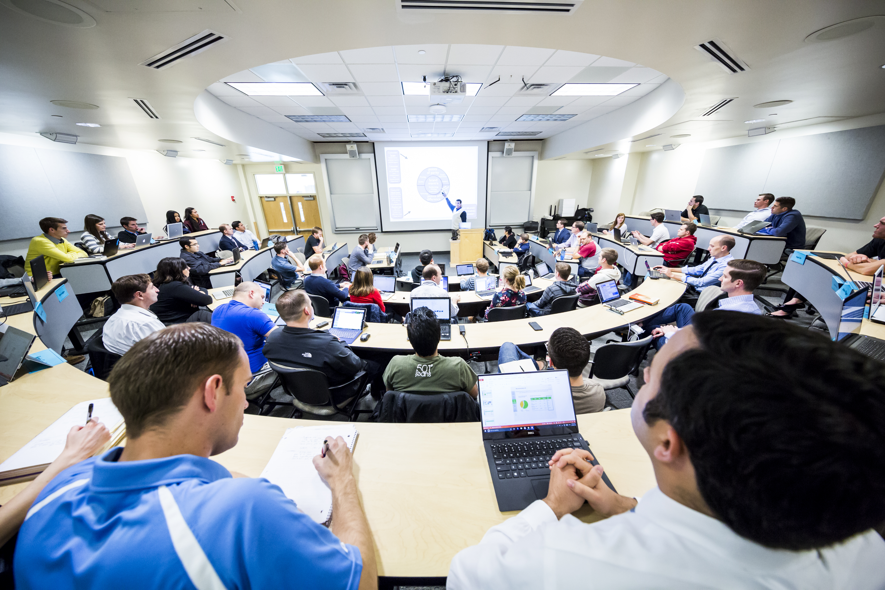
2. Post Internships From Employers/Contacts
Have your department or area create their own Handshake account.
Examples – Life Science; Pre-Professional Advisement
Instructions for this will be sent to you with this presentation “BYU Handshake How to Guide For Campus Partners” Example BYU Handshake Guidebook
If you have any questions or help to set these up contact Will Tenney William_tenney@byu.edu or Beth Hiatt Beth_hiatt@byu.edu
Notes:
WILL –.
ONCE THE ADVISORS GIVES THE GO AHEAD THEN THE ACADEMIC VPS OFFICE RPOCESSES THE REQUEST FOR FINAL APPROVAL.
CEL WILL FOLLOW UP – ONCE APPROVED
CEL CONFIRMS THE VENUE WITH CAMPUS SCHEDULEING
AND POST THE EVENT ON BYU.CLUBS
AND THEN APPROVE ON HANDSHAKE AND ATTACH ANY MARKETING MATERIAL
CEL WILL SHARE WITH CDS
TRACK ATTENDANCE (NEXT SLIDE)

Slide 6
3. Employers/Contacts to Post Internships
Employers to post their internships themselves
If they need help setting this up send them the “BYU How to Guidebook for Internships” we will send this to you
If they have any questions they can contact Will Tenney William_tenney@byu.edu or Beth Hiatt Beth_hiatt@byu.edu
Notes:
BETH –
LET US KNOW SO WE CAN HELP YOU NAVIGATE SIGNING UP PROCCESS AND ALSO WORK WITH THOSE APPROVING EMPLOYERS TO APPROVE YOU STRAIGHT WAY.

Slide 7

We will send you all documents as mentioned in this presentation.
Feel free to contact us if you have any questions -
William_tenney@byu.edu
Beth_hiatt@byu.edu
Notes:
WILL –
OPEN UP FOR QUESTIONS, DO YOU HAVE ANY QUESTIONS FOR BETH AND I.
THANK YOU AGAIN FOR TAKING THE TIME TO BE ON THIS CALL, WE HOPE THAT YOU SEE THE VALUE OF PARTNERING WITH CEL, IT WILL BENEFIT YOUR MEMBERS BY CONNECTING WITH EMPLOYERS AND UTULIZING THE RESOURCES THAT CEL HAS TO OFFER FOR FUTURE CAREERS AFTER COLLEGE.
HERE ARE OUR EMAIL ADDRESSES - FEEL FREE TO EMAIL US SO WE CAN MOVE FORWARD WITH THIS PARTNERSHIP.
YOU ALL HAVE A GREAT REST OF YOUR DAY!!

